Slide 1
Detailed evolution of performance metrics
Folding
Judit Gimenez (judit@bsc.es)
Petascale workshop 2013

Slide 2
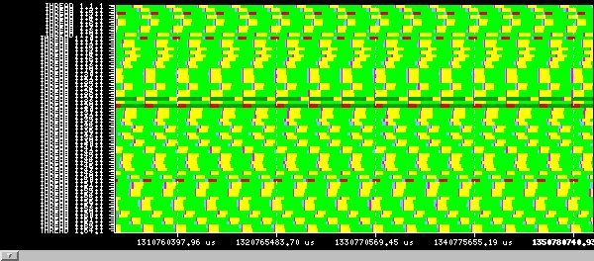
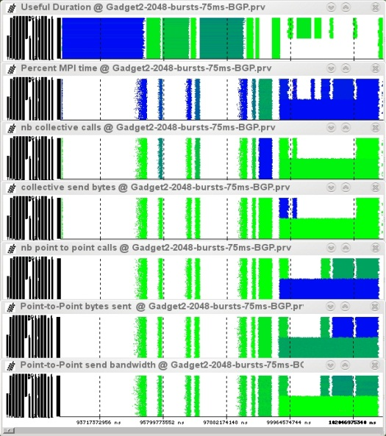
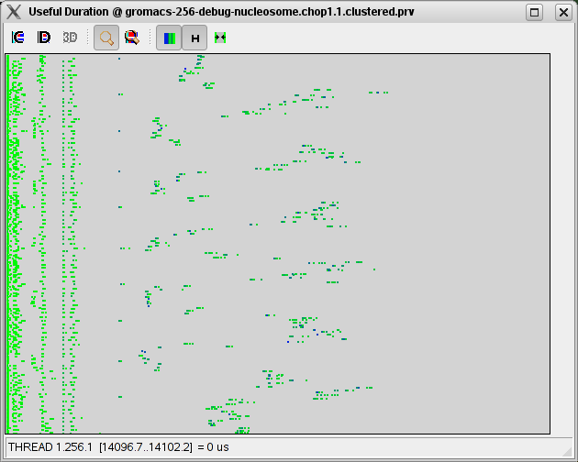
Our Tools
Since 1991
Based on traces
Open Source
  http://www.bsc.es/paraver
Core tools:
  Paraver (paramedir) – offline trace analysis
  Dimemas – message passing simulator
  Extrae – instrumentation
Performance analytics
  Detail, flexibility, intelligence
  Behaviour vs syntactic structure

Slide 3
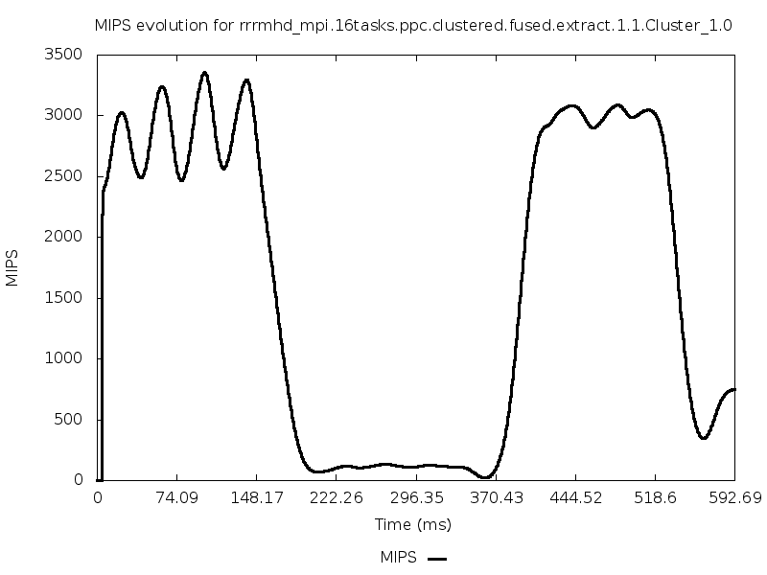

What is a good performance?
Performance of a sequential region = 2000 MIPS
Is it good enough?
Is it easy to improve?

Slide 4
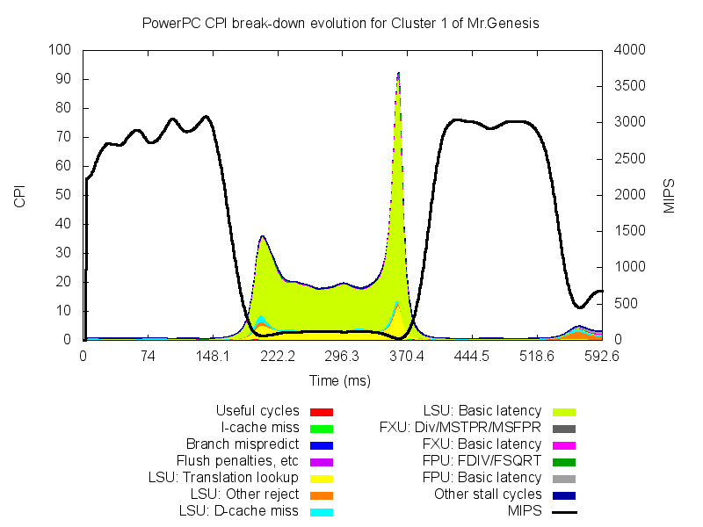
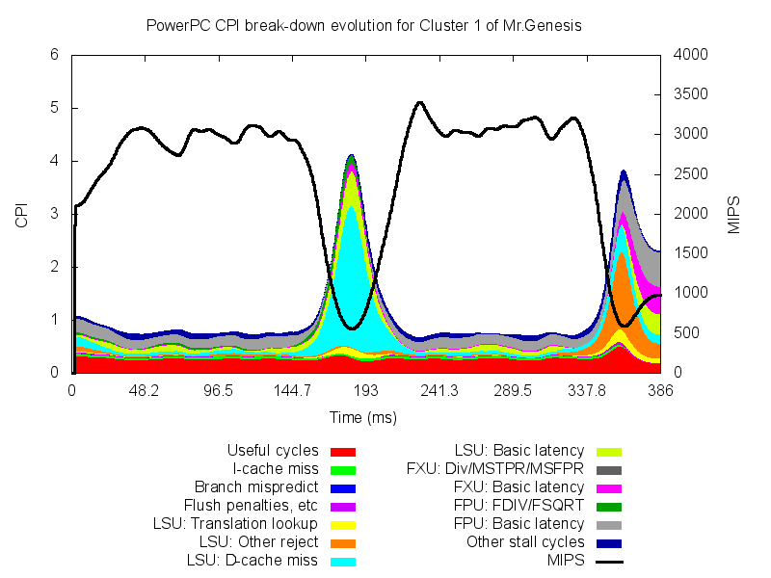
What is a good performance?
MR. GENESIS
Interchanging loops

Slide 5
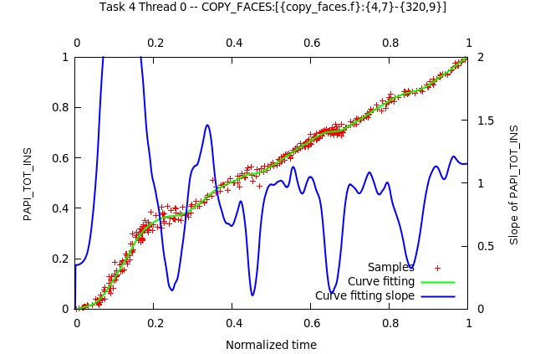
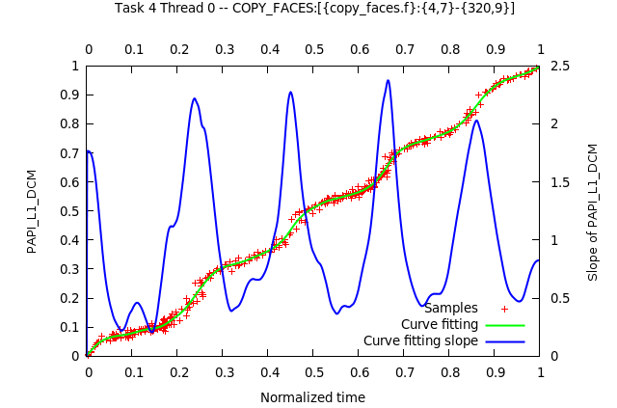
Can I get very detailed perf. data with low overhead?
Application granularity vs. detailed granularity
  Samples: hardware counters + callstack
Folding: based on known structure: iterations, routines, clusters;
  Project all samples into one instance
Extremely detailed time evolution of hardware counts, rates and callstack with minimal overhead
  Correlate many counters
  Instantaneous CPI stack models
Unveiling Internal Evolution of Parallel Application Computation Phases (ICPP 2011)

Slide 6
Mixing instrumentation and sampling
Benefit from applications’ repetitiveness
Different roles
  Instrumentation delimits regions
  Sampling reports progress within a region
Iteration #1
Iteration #2
Iteration #3
Synthetic Iteration
Unveiling Internal Evolution of Parallel Application Computation Phases (ICPP 2011)

Slide 7
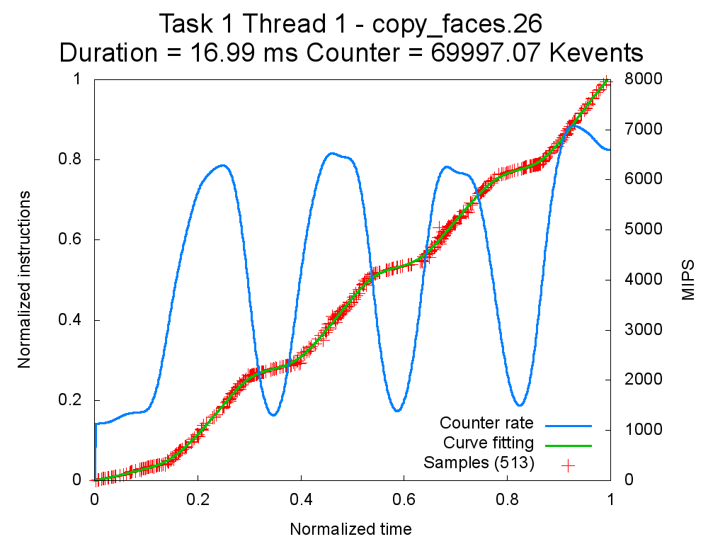
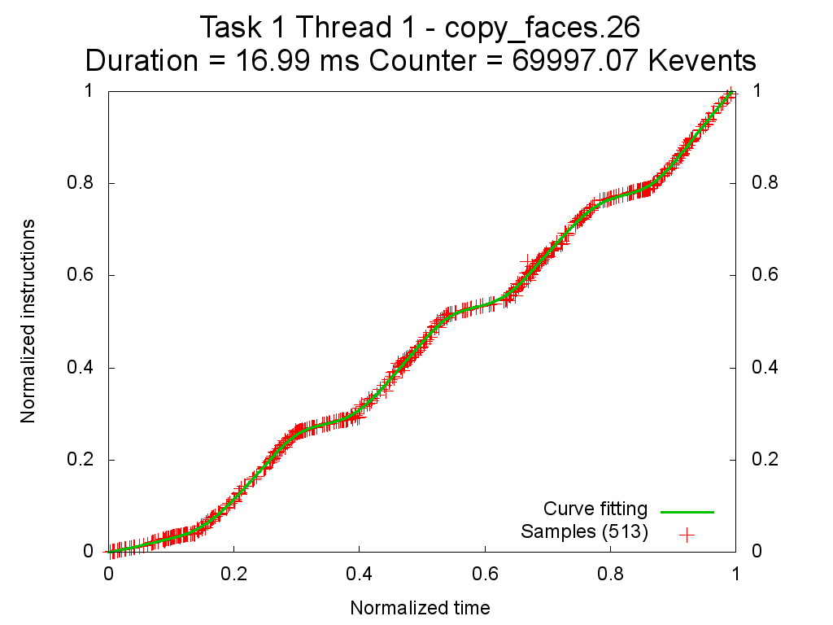
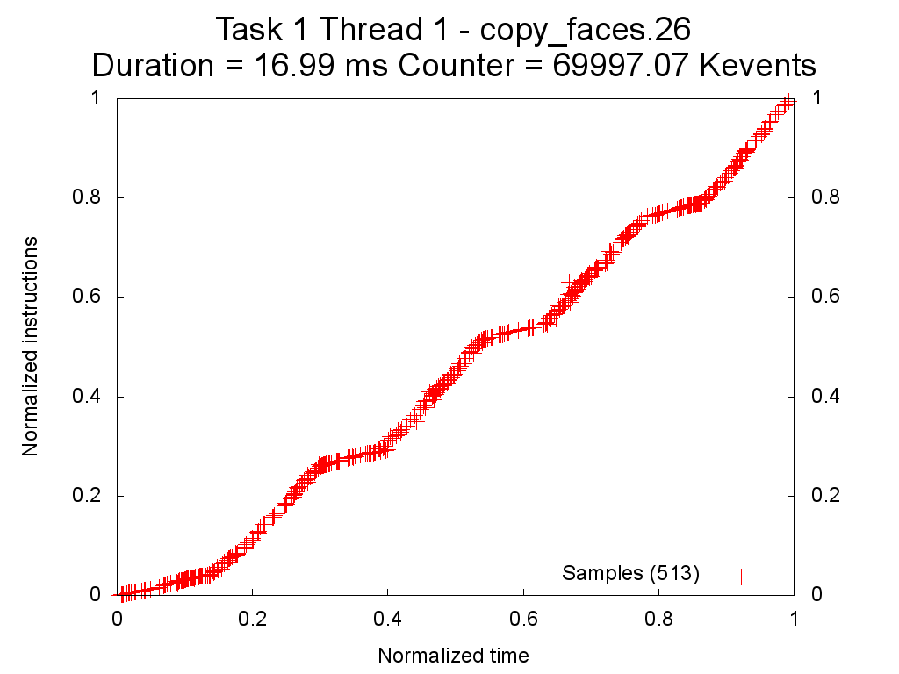
Folding hardware counters
Instructions evolution for routine copy_faces of NAS MPI BT.B
Red crosses represent the folded samples and show the completed instructions from the start of the routine
Green line is the curve fitting of the folded samples and is used to reintroduce the values into the tracefile
Blue line is the derivative of the curve fitting over time (counter rate)
Notes:
Explain folding results: crosses are folded samples, completed instruction from the begin of the region
Green line is interpolated and is reintroduced in the tracefile.
Blue line is the derivative to calculate the counter rate at a time.
The plot here shows the folding results in respect of the hardware counters when applying to the copy_faces routine of the BT benchmark. On the left Y axis there is the normalized value for the metric, whereas on the X axis there is the time. We are showing here the result of the folding mechanism. On the left Y axis there is the normalized value for the metric, whereas on the X axis there is the time.
The red crosses represent the folded samples of the 200 iterations that occurred within copy_faces. Each cross represents the completed instructions from the beginning of the routine but from many instances of the routine.
(click)
The green line shows the result of the interpolation of the cloud of points. The interpolation is used to feedback the tracefile with the folded results.
(click)
With all the metrics we have we can also compute the metrics rate (MIPS in the example) by calculating the derivative of the green line. The blue curve shows the MIPS rate helps finding different computation phases by their metrics rate (on the secondary Y axis).
7

Slide 8
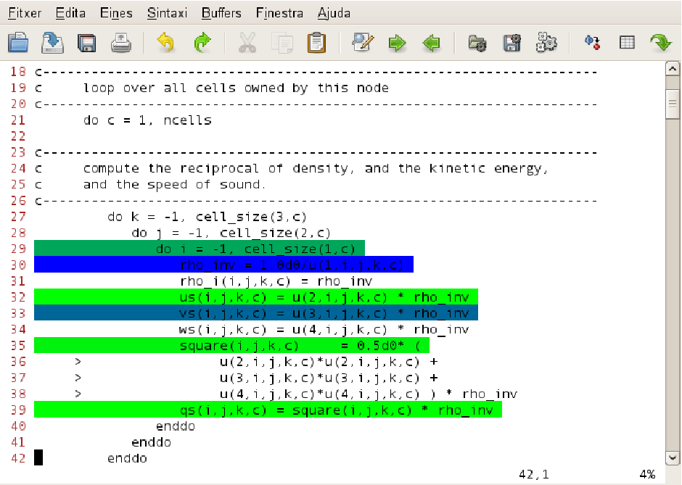
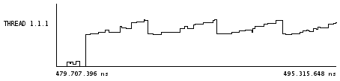
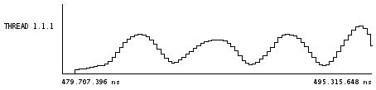
Folding hardware counters with call stack
Folded source code line
Folded instructions

Slide 9
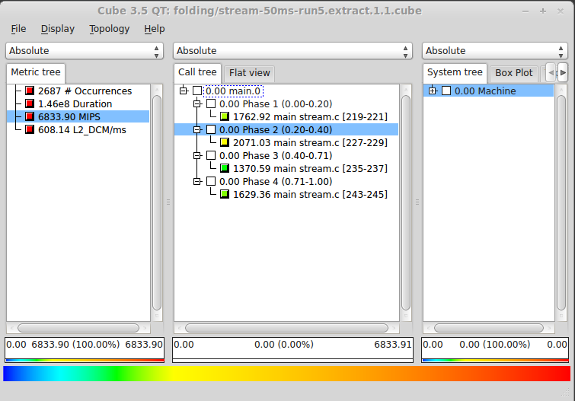
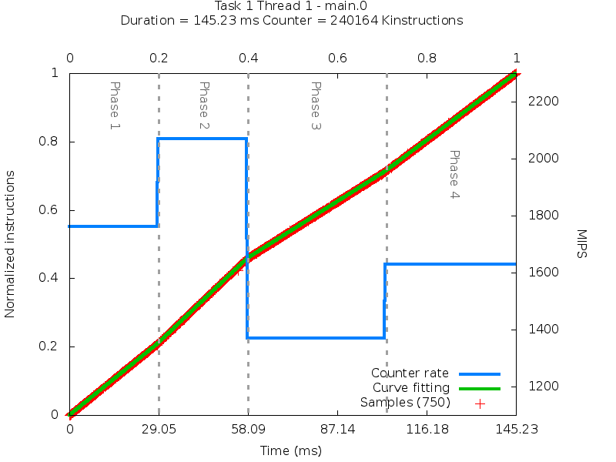
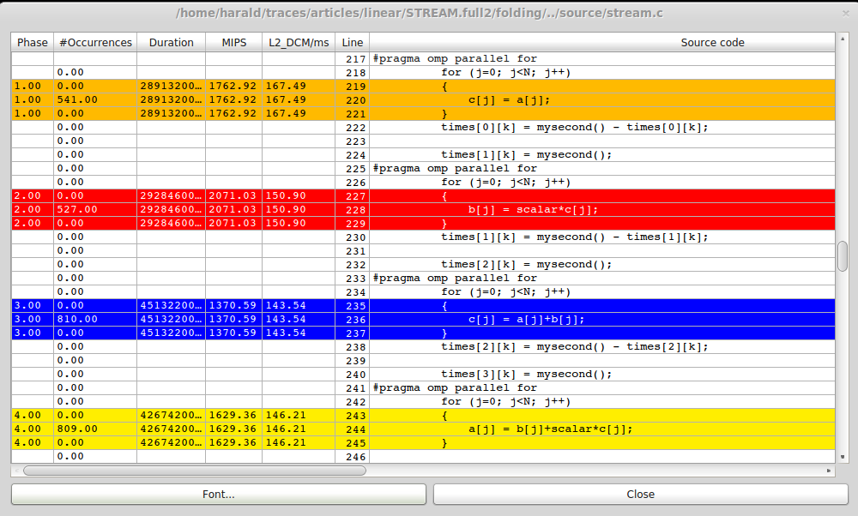
Folding hardware counters with call stack (CUBE)

Slide 10
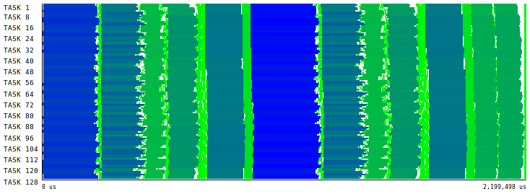
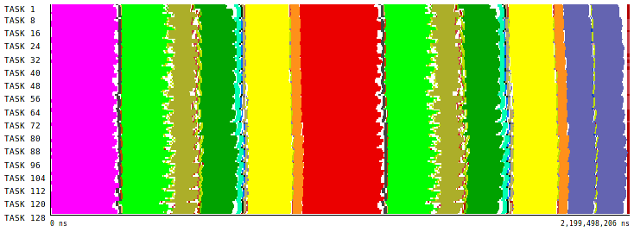
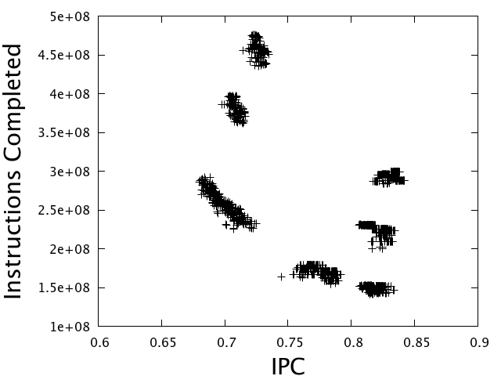
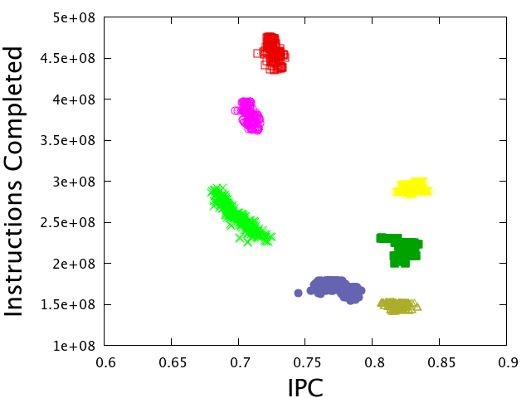
Using Clustering to identify structure
Bursts Duration
Automatic Detection of Parallel Applications Computation Phases. (IPDPS 2009)
Notes:
Computation bursts. Regions between calls to the parallel runtime.
For example, we can see multiple time-lines, different views.
We provide a different view. Erase the time and space component, and represent them using a scatter plot of performance counters.
Explain scatter.
The we apply a cluster algorithm.

Slide 11
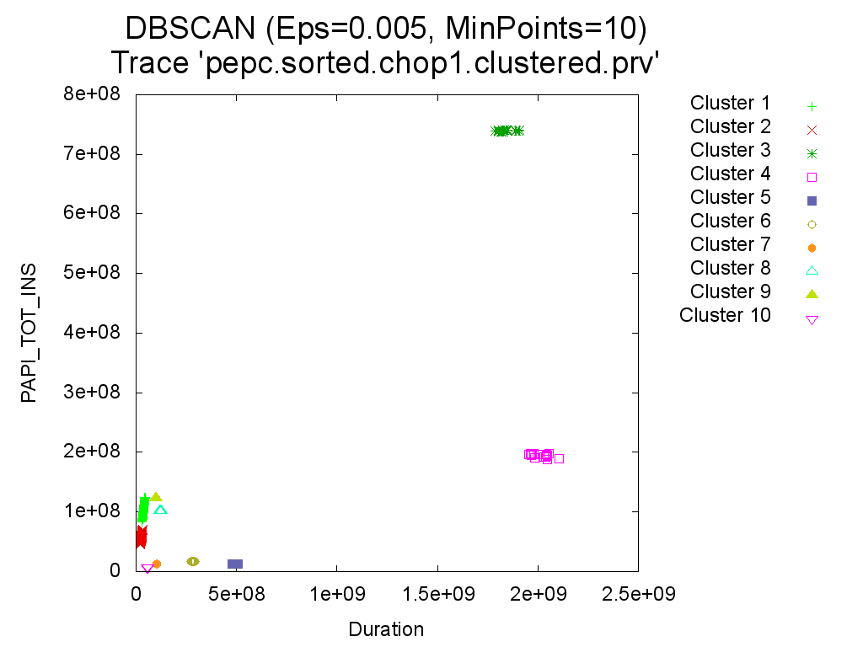
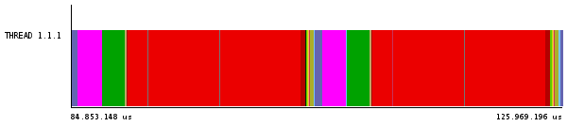
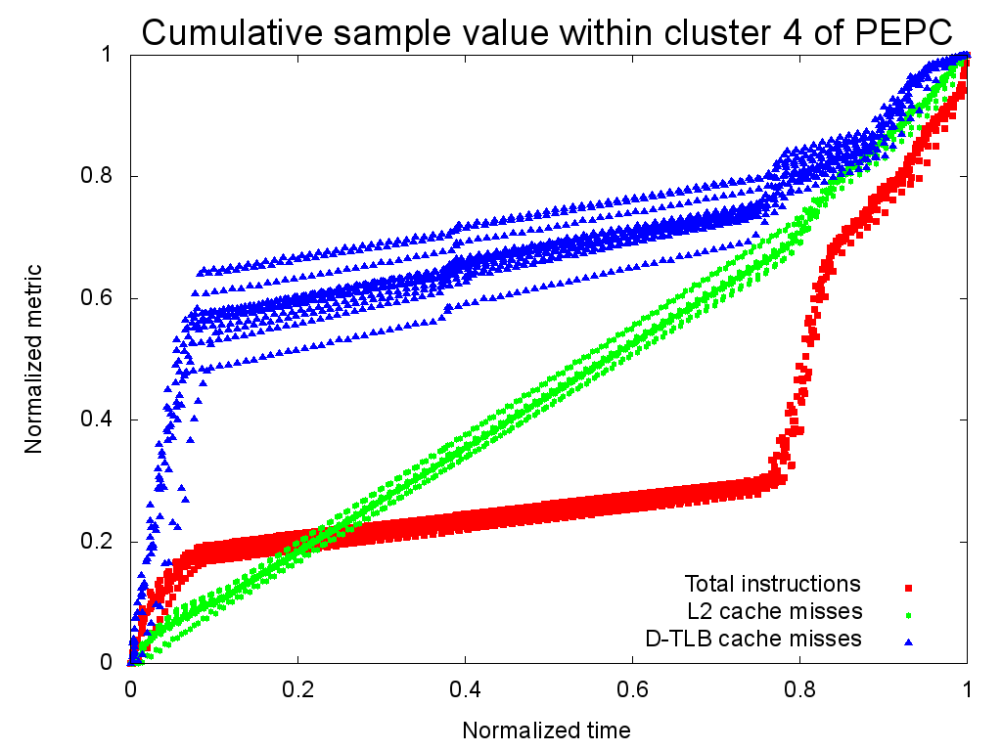
Example 1: PEPC
96 MIPS
do i = 1, n
htable(i)%node = 0
htable(i)%key = 0
htable(i)%link = -1
htable(i)%leaves = 0
htable(i)%childcode = 0
End do
htable%node = 0
htable%key = 0
htable%link = -1
htable%leaves = 0
htable%childcode = 0
_{A}
Performance metrics (Region A)
16 MIPS
2.3 M L2 misses/s
0.1 M TLB misses/s
Changes
-70% time
-18% instructions
-63% L2 misses
-78% TLB misses
253 MIPS (+163%)
Notes:
11
Falladas de tlb/sec?
Posar en quina maquina sha executat cadascuna de les aplicaci
Marques mes petites
MIPS en rojo, otras metricas en sus colores

Slide 12
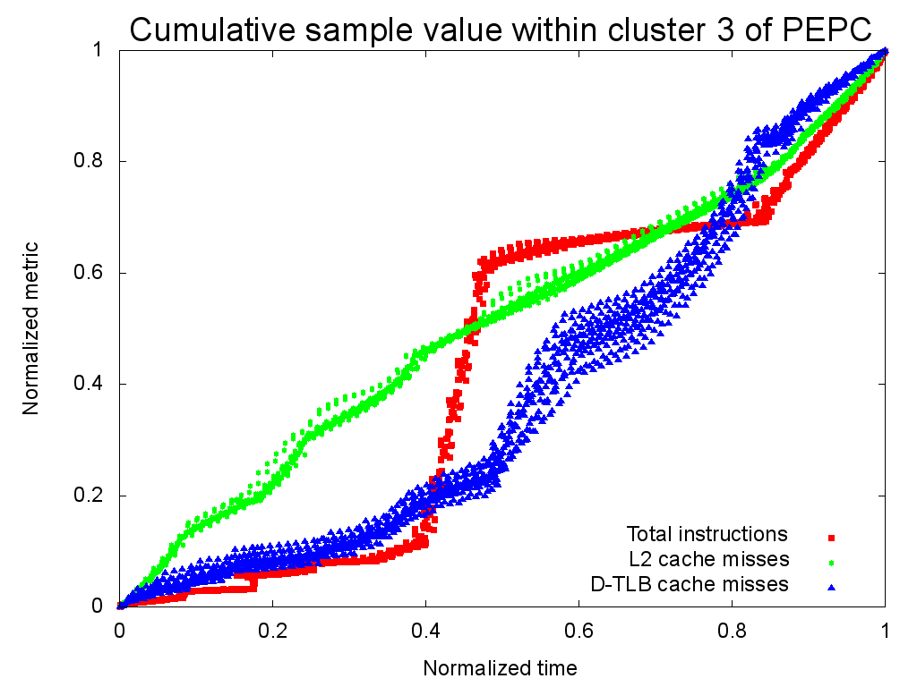
Example 1: PEPC
403 MIPS
_{A}
_{B}
Performance metrics
Region A | Region B
100 MIPS | 80 MIPS
4 M L2 misses/s | 2 M L2 misses/s
0.4 M TLB misses/s | 1 M TLB misses/s
Notes:
12
Falladas de tlb/sec?
Posar en quina maquina sha executat cadascuna de les aplicaci
Marques mes petites
MIPS en rojo, otras metricas en sus colores

Slide 13
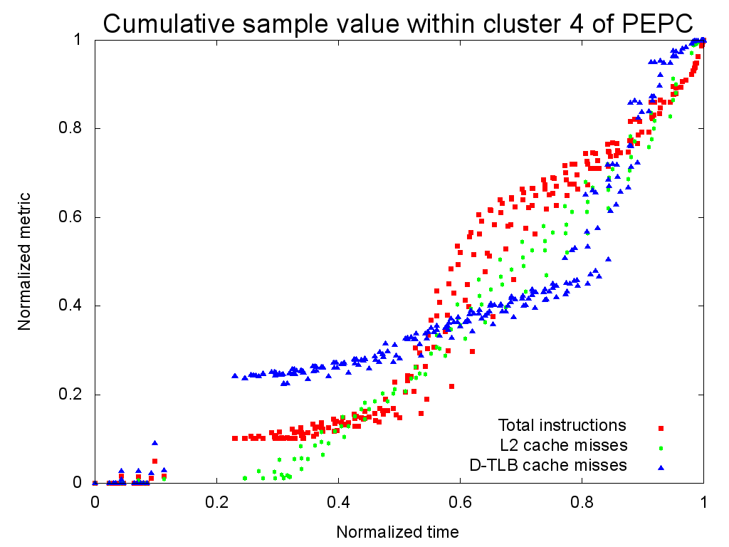
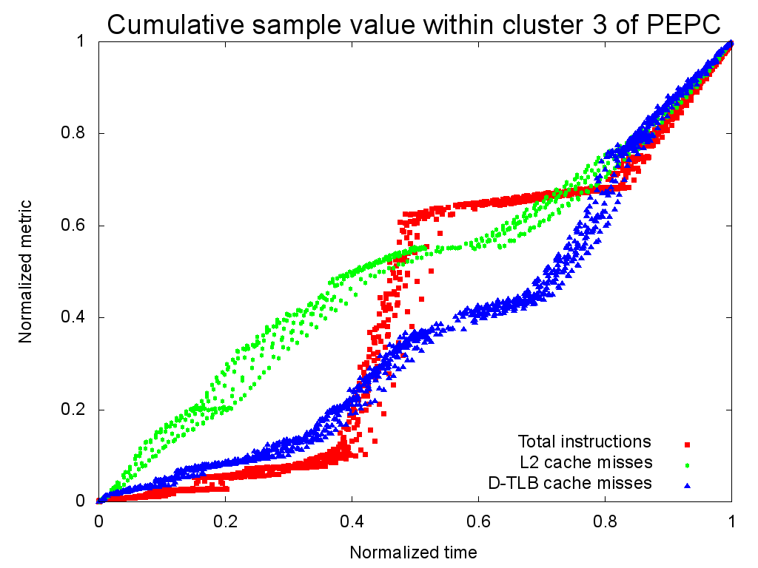
Example 1: PEPC
Changes
-70% time
-18% instructions
-63% L2 misses
-78% TLB misses
253 MIPS (+163%)
Changes
-30% time
-1% instructions
-10% L2 misses
-32% TLB misses
544MIPS (+34%)
Notes:
13
Marcas para comparar valores absolutos?
-> falladas de tlb/sec?

Slide 14
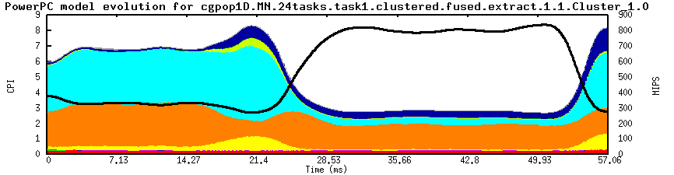


Example 2: CG-POP with CPI-Stack
Folded lines
  Interpolation → statistic profile
Points to “small” regions
iter_loop: do m = 1, solv_max_iters
sumN1=c0
sumN3=c0
do i=1,nActive
Z(i) = Minv2(i)*R(i)
sumN1 = sumN1 + R(i)*Z(i)
sumN3 = sumN3 + R(i)*R(i)
enddo
do i=iptrHalo,n
Z(i) = Minv2(i)*R(i)
enddo
call matvec(n,A,AZ,Z)
sumN2=c0
do i=1,nActive
sumN2 = sumN2 + AZ(i)*Z(i)
enddo
call update_halo(AZ)
...
do i=1,n
stmp = Z(i) + cg_beta*S(i)
qtmp = AZ(i) + cg_beta*Q(i)
X(i) = X(i) + cg_alpha*stmp
R(i) = R(i) - cg_alpha*qtmp
S(i) = stmp
Q(i) = qtmp
enddo
end do iter_loop
A
B
C
B
D
C
D
A
pcg_chrongear_linear
matvec
Line number
Framework for a Productive Performance Optimization
(PARCO Journal 2013)

Slide 15
Example 2: CG-POP
sumN1=c0
sumN3=c0
do i=1,nActive
Z(i) = Minv2(i)*R(i)
sumN1 = sumN1 + R(i)*Z(i)
sumN3 = sumN3 + R(i)*R(i)
enddo
do i=iptrHalo,n
Z(i) = Minv2(i)*R(i)
enddo
iter_loop: do m = 1, solv_max_iters
sumN2=c0
call matvec_r(n,A,AZ,Z,nActive,sumN2)
call update_halo(AZ)
...
sumN1=c0
sumN3=c0
do i=1,n
stmp = Z(i) + cg_beta*S(i)
qtmp = AZ(i) + cg_beta*Q(i)
X(i) = X(i) + cg_alpha*stmp
R(i) = R(i) - cg_alpha*qtmp
S(i) = stmp
Q(i) = qtmp
Z(i) = Minv2(i)*R(i)}
if (i <= nActive) then}
sumN1 = sumN1 + R(i)*Z(i)
sumN3 = sumN3 + R(i)*R(i)
endif
enddo
end do iter_loop
iter_loop: do m = 1, solv_max_iters
sumN1=c0
sumN3=c0
do i=1,nActive
Z(i) = Minv2(i)*R(i)
sumN1 = sumN1 + R(i)*Z(i)
sumN3 = sumN3 + R(i)*R(i)
enddo
do i=iptrHalo,n
Z(i) = Minv2(i)*R(i)
enddo
call matvec(n,A,AZ,Z)
sumN2=c0
do i=1,nActive
sumN2 = sumN2 + AZ(i)*Z(i)
enddo
call update_halo(AZ)
...
do i=1,n
stmp = Z(i) + cg_beta*S(i)
qtmp = AZ(i) + cg_beta*Q(i)
X(i) = X(i) + cg_alpha*stmp
R(i) = R(i) - cg_alpha*qtmp
S(i) = stmp
Q(i) = qtmp
enddo
end do iter_loop
B
CD
C
D
AB
A

Slide 16
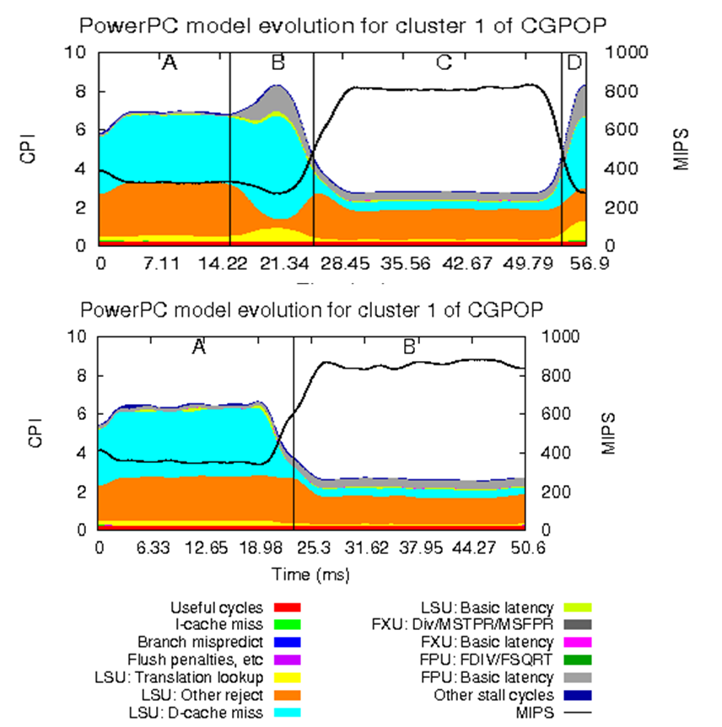
Example 2: CG-POP
11% improvement on an already optimized code
A
B
C
D
AB
CD
AB
CD

Slide 17
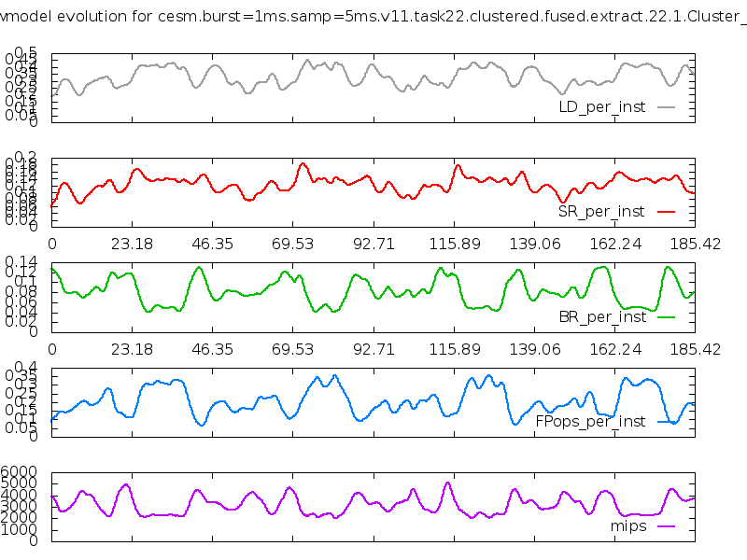
Example 3: CESM

Slide 18
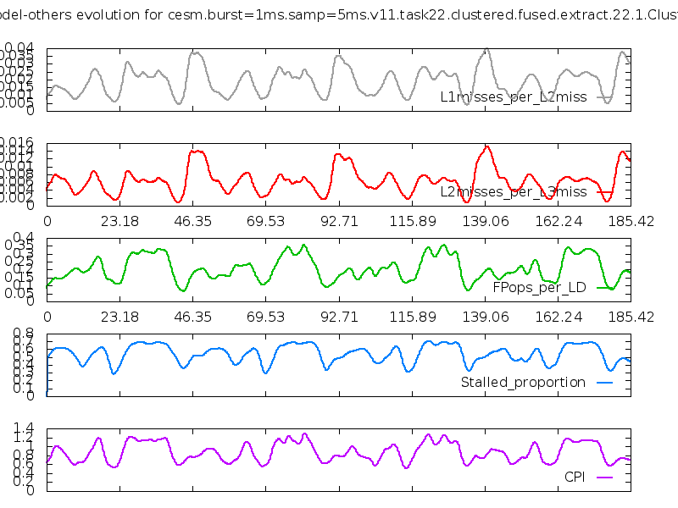
Example 3: CESM

Slide 19
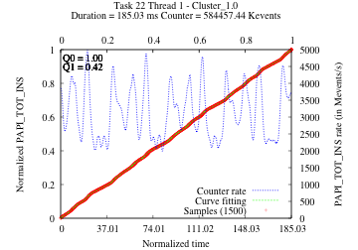
Example 3: CESM
4 cycles in Cluster 1
Group A:
  conden: 2.7%
  compute_uwshcu: 3.3%
  rtrnmc: 1.75%
Group B:
  micro_mg_tend: 1.36% (1.73%)
  wetdepa_v2: 2.5%
Group C:
  reftra_sw: 1.71%
  spcvmc_sw: 1.21%
  vrtqdr_sw 1.43%
A
B
C

Slide 20
Example 3: CESM
Consists of a double nested loop
  Very long ~400 lines
  Unnecessary branches with inhibit vectorization
Restructuring wetdepa_v2
  Break up long loop to simplify vectorization
  Promote scalar to vector temporaries
  Common expression elimination
 | CESM B-case, NE=16, 570 cores Yellowstone, Intel (13.1.1) –O2
 | % total time | duration (ms) | improvement
original | 2.5 | 492.6 | -
modified | 0.73 | 121.1 | 4.07x

Slide 21
Energy counters @ SandyBridge
3 Energy Domains
  Processor die (Package)
  Cores (PP0)
  Attached RAM (optional, DRAM)
In comparison with performance counters
  Per processor die information
  Time discretization
    Measured at 1Khz
      → No control on boundaries (f.i separate MPI from computing)
  Power quantization
    Energy reported in multiples of 15.3 µJoules
Folding energy counters
  Noise values
    Discretization – consider a uniform distribution?
    Quantization – select the latest valid measure?

Slide 22
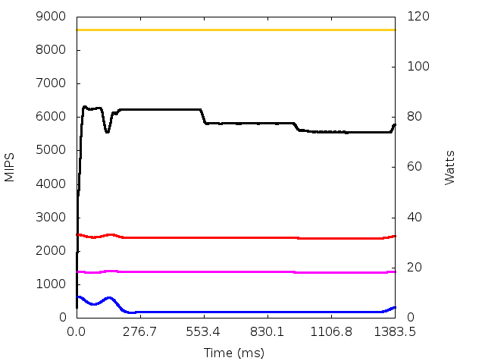
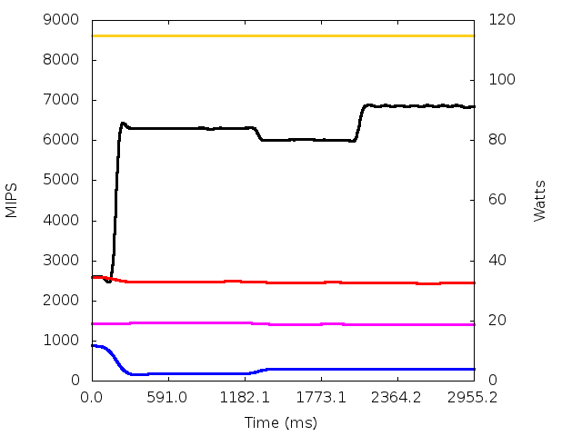
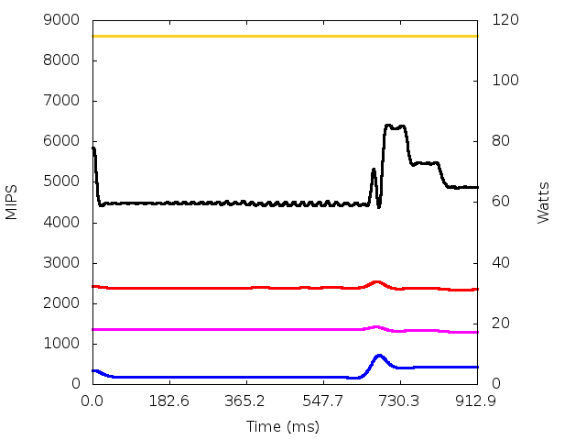
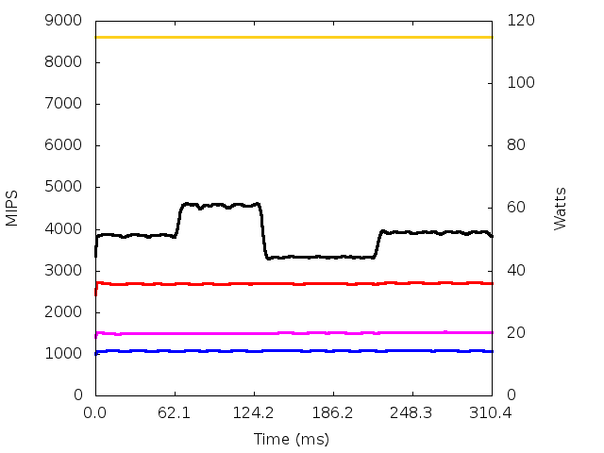
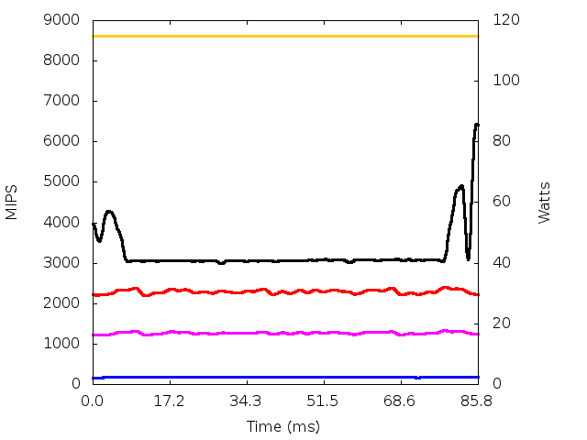
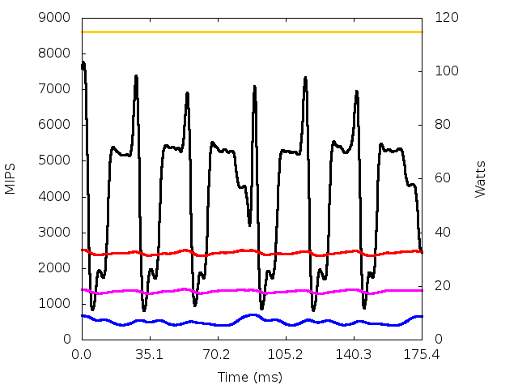
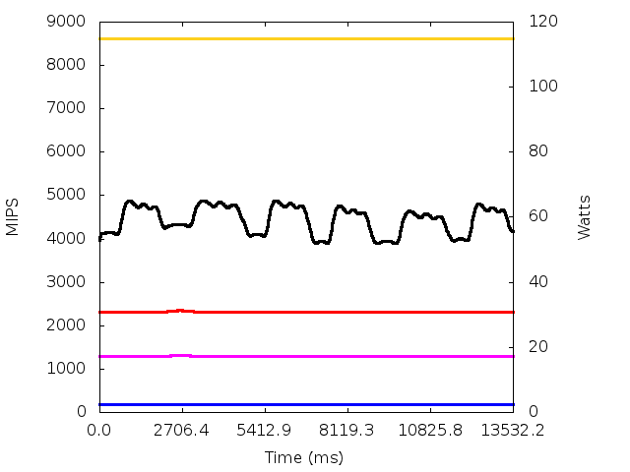
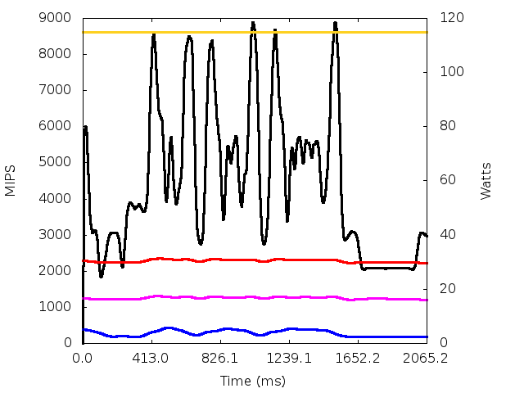
Folding energy counters in serial benchmarks
MIPS Core DRAM PACKAGE TDP
BT.B
FT.B
LU.B
Stream
435.gromacs
437.leslie3d
444.namd
481.wrf

Slide 23
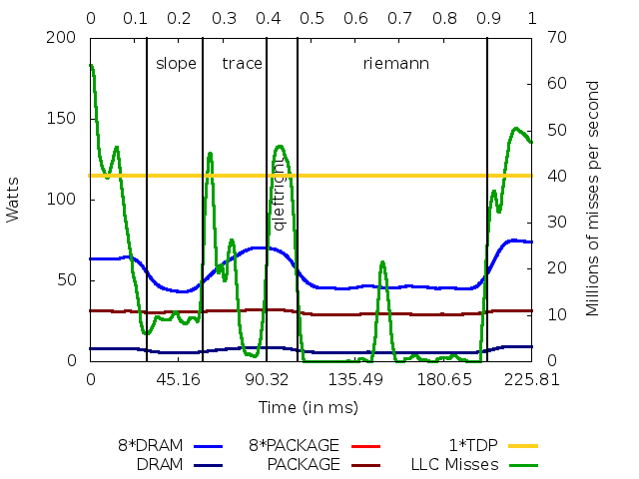
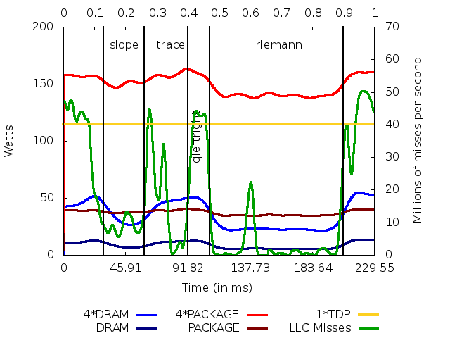
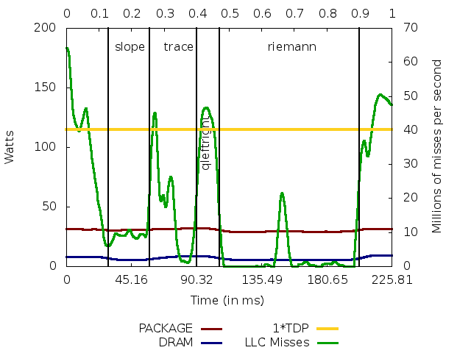
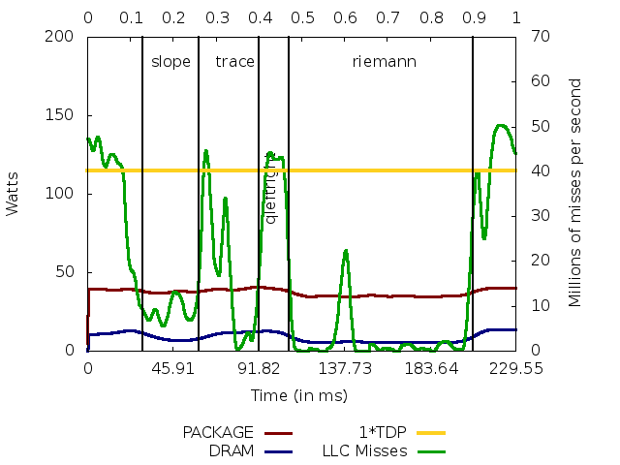
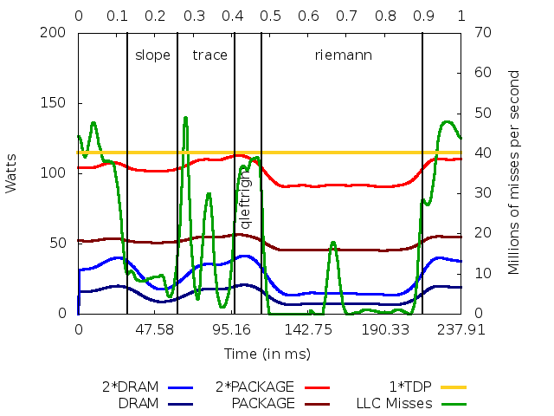
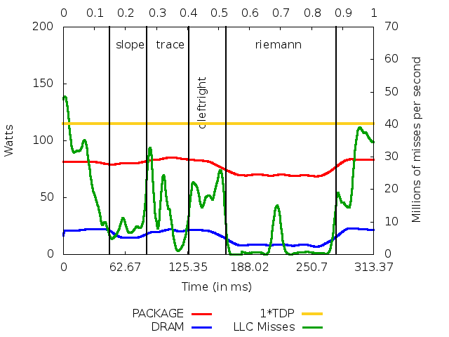
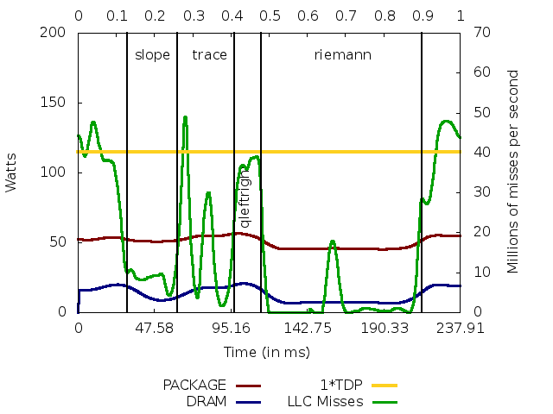
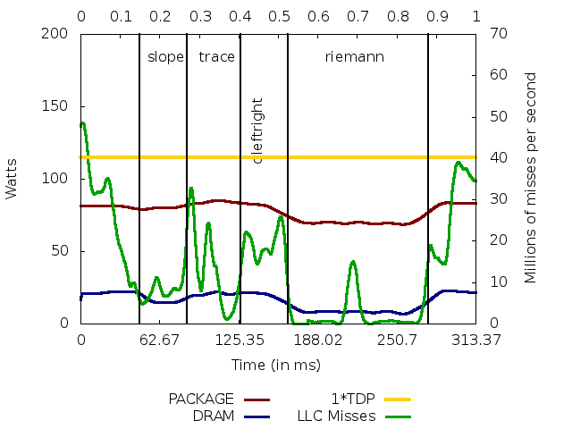
HydroC analysis
HydroC, 8 MPI processes
  Intel® Xeon® E5-2670 @ 2.60GHz (2 x octo-core nodes)
1 pps
2 pps
4 pps
8 pps

Slide 24
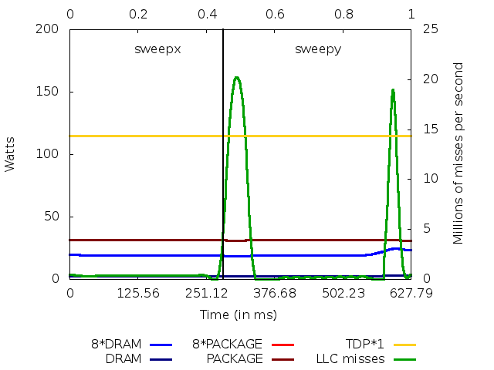
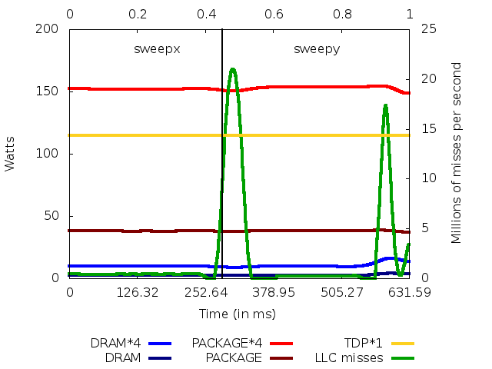






MrGenesis analysis
MrGenesis, 8 MPI processes
  Intel® Xeon® E5-2670 @ 2.60GHz (2 x octo-core nodes)
1 pps
2 pps
4 pps
8 pps

Slide 25
Conclusions
Performance answers are in detailed and precise analysis
Analysis: [temporal] behaviour vs syntactic structure
www.bsc.es/paraver
Notes:
25

