Slide 1
Automating Auto Tuning
Jeffrey K. Hollingsworth
University of Maryland
hollings@cs.umd.edu

Slide 2
Auto-tuning Motivation
Example, a dense matrix multiple kernel
Various Options:
Original program: 30.1 sec
Hand Tuned (by developer): 11.4 sec
Auto-tuned of hand-tuned: 15.9 sec
Auto-tuned original program: 8.5 sec
What Happened?
Hand tuning prevented analysis
Auto-tuned transformations were then not possible
Notes:
To solve those problems, we developed the Active Harmony system. The Harmony is a real time performance optimization system. It helps the application to selection the appropriate underlying programming library. That is, it select the “right code” to use. In order to do so, it monitors the performance for all underlying programming libraries. Then during execution, it will switch among those programming libraries if necessary.
After selecting the appropriate underlying programming library, it will also tune the library together with all other parameters. The system monitors the whole system performance and adjust the tunable parameters during runtime.

Slide 3
Automated Performance Tuning
Goal: Maximize achieved performance
Problems:
Large number of parameters to tune
Shape of objective function unknown
Multiple libraries and coupled applications
Analytical model may not be available
Requirements:
Runtime tuning for long running programs
Don’t try too many configurations
Avoid gradients

Slide 4
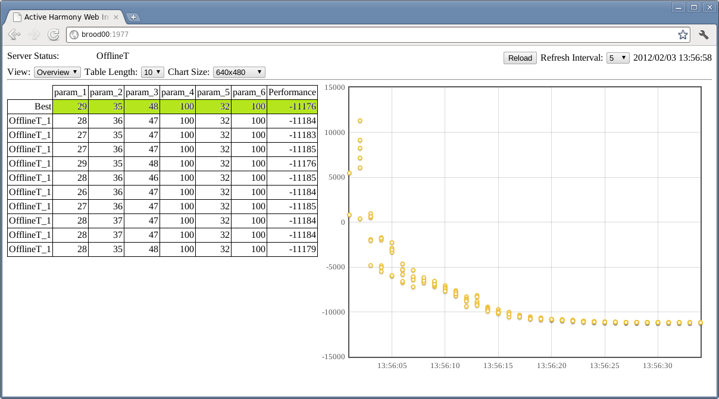
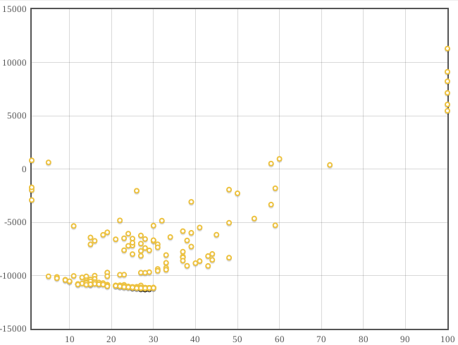
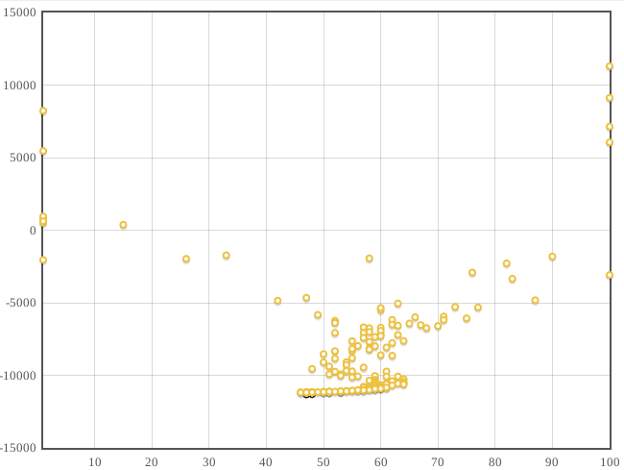
Easier Auto-tuning: Improve User Interface
Web-based UI written in HTML/Javascript
Reduced overhead on Harmony Server
Allows isolated view of single dimension
HTTP deals with dropped connections better than X

Slide 5
Easier Auto-tuning: Lower Barriers to Use
Problem:
Hard to get codes ready for auto-tuning
Tools can be complex
Tuna: auto-tuning shell
Hides details of auto-tuning
Use:
Program print performance as final output line
Auto-tuner invoked programs via command line arguments
Program can be shell script
including compilation
config file generation

Slide 6
Easier Auto-tuning: Tuna
> ./tuna -i=tile,1,10,1 -i=unroll,2,12,2 -n=25 matrix_mult -t % -u %
Parameter 1
Low: 1
High: 10
Step: 1
Parameter 2
Low: 2
High: 12
Step: 2
Command line to run
% - replaced by
paramters

Slide 7
Easier Auto-tuning: Language Help
Problem:
How to express tunable options
Chapel
Already supports Configuration Variables
Sort of like a constant
Defined in program
Given a value by programmer
But
User can change value at program launch
Proposed Extensions to Language
Add range to Configuration Variable
Include Range in –help output
Include machine readable version of –help

Slide 8
Tuna + Chapel
> ./quicksort --help | tail -5
quicksort config vars:
n: int(64)
thresh: int(64)
verbose: int(64)
timing: bool
Auto-tuning parameters
Threads, Tasks: defaults of Chapel runtime
Thresh: Configuration variable from program

Slide 9
LULESH in Chapel on Problem Size 32³
Default | 28.3
Min | 24.4 | @ (44, 256)
Speedup | 13.9%

Slide 10
LULESH in Chapel on Problem Size 48³
Default | 102.5
Min | 89.9 | @ (76, 256)
Speedup | 12.3%

Slide 11
Auto-Tuning Deconstructed
Evaluated Performance
Active
Harmony
Client
Application
REPORT
3
2
1
Search
Strategy
3
2
1
FETCH
Candidate Points
Notes:
The remaining piece that completes our vision for a generalized auto-tuning framework is the ability to trigger functionality as configurations leave and enter the auto-tuner. We implement this via plug-in’s that are stackable.

Slide 12
Onion Model Workflow
Allows for paired functionality, but either hook is optional.
Fetch hooks executed in ascending order.
Report hooks executed in descending order.
Point values cannot be modified (directly).
REPORT
Search
Strategy
3
2
1
FETCH
Notes:
Any number of plug-ins can loaded into a tuning session. There are three plug-ins illustrated here, organized as layers of an onion. Like search strategies, plug-in’s have two major interfaces.

Slide 13
Plug-in Workflow: ACCEPT
Indicates successful processing at this level.
Plug-in relinquishes control of the point to entity below.
Search
Strategy
3
2
1

Slide 14
Plug-in Workflow: RETURN
Allows a short-circuit in the feedback loop.
Plug-in must provide the performance value.
Processing resumes at the same level from the report workflow.
Search
Strategy
3
2
1

Slide 15
Plug-in Workflow: REJECT
Allows modification of the search indirectly.
Plug-in must provide an alternate valid point.
Search strategy is not obligated to use it.
Processing jumps directly back to search strategy.
Search
Strategy
3
2
1

Slide 16
Plug-in Example: Point Logger
logger_init()
{
outfd = open(“performance.log”);
}
logger_report(flow_t *flow, point_t *pt, double perf)
{
fprintf(outfd, “%s -> %lf\n”, string(pt), perf);
flow->type = ACCEPT;
}
logger_fini()
{
close(outfd);
}

Slide 17
Plug-in Example: Constraints
Support for non-rectangular parameter spaces.
Implemented as plug-in #2 using REJECT workflow.
$y≤x$
Search
Strategy
$$y$$
3
2
1
$$x$$

Slide 18
Conclusions and Future Work
Ongoing Work
Getting features into Chapel
Communication Optimization
Re-using data from prior runs
Conclusions
Auto tuning can be done at many levels
Offline – using training runs (choices fixed for an entire run)
Compiler options
Programmer supplied per-run tunable parameters
Compiler Transformations
Online –training or production (choices change during execution)
Programmer supplied per-timestep parameters
Compiler Transformations
It Works!
Real programs run faster

