Slide 1
Scalable Library Loading with SPINDLE
CScADS 2013
July 12, 2013
Matt LeGendre, Wolfgang Frings, Dong Ahn, Todd Gamblin, Bronis de Supinski, Felix Wolf

Slide 2
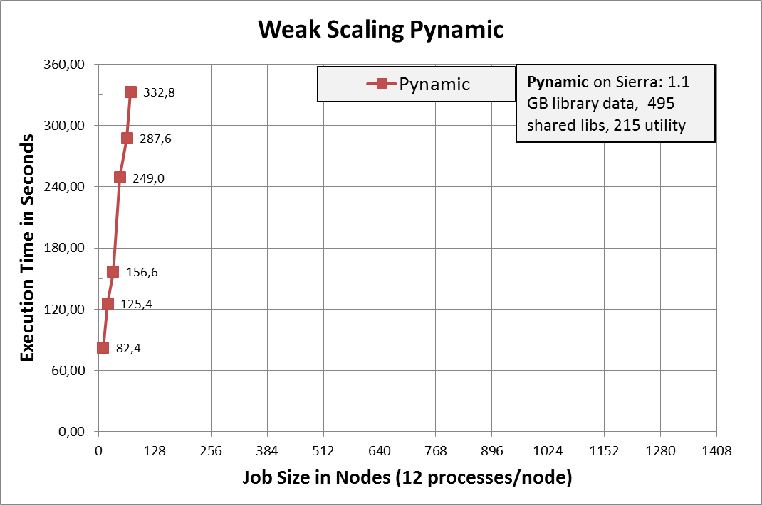
Dynamic Linking Causes Major Disruption at Scale
Multi-physics applications at LLNL
848 shared library files
Load time on BG/P:
2k tasks → 1 hour
16k tasks → 10 hours
Pynamic
LLNL Benchmark
Loads shared libraries and python files
495 shared objects → 1.1 GB
Pynamic running on LLNL Sierra Cluster
1944 nodes, 12 tasks/node, NFS and Lustre file system

Slide 3
Challenges Arise from File Access Storms
Caused by dynamic linker
searching and
loading dynamic linked libraries
Formulas:
File metadata operations:
# of tests = # of processes
x # of locations
x # of libraries
File read operations:
# of reads = # of processes
x # of libraries
Example: Pynamic Benchmark on Sierra-Cluster
serial (1 task): 5,671 open/stat calls
parallel (23,328 tasks) : 132,293,088 open/stat calls

Slide 4
File Access is Uncoordinated!
Loading is nearly unchanged since 1964 (MULTICS)
ld-linux.so uses serial POSIX file operations that are not coordinated among process.
dynamic linker
Process
lib
lib
…
dynamic linker
Process
lib
lib
lib
lib
lib
lib
…
lib
lib
lib
dynamic linker
lib
Process
lib
lib
…
dynamic linker
Process
lib
lib

Slide 5
How SPINDLE Works
dynamic linker
Requesting dir/file:
1. Request from leader
2. Leader reads from disk
3. Leader distributes to peers
✓
Process
✓
dir
dir req
file
File Req
✓
…
✓
dynamic linker
✓
✓
Process
dir
file
dir
file
…
dynamic linker
DIR
Process
FILE
dir
dir
file
file
…
dynamic linker
Process
dir
file
dir
file
File metadata operations:
# of tests = # of locations
File read operations:
# of reads = # of libraries
SPINDLE: Scalable Parallel Input Network for Dynamic Load Environments

Slide 6
Overview
Design & Implementation:
Components of SPINDLE
Interaction with the dynamic linker (client-side)
Strategies for caching and data distribution (Pull- or Push-Model)
Communication between SPINDLE server (overlay network)
Performance
Memory Usage
Usage and features of SPINDLE

Slide 7
SPINDLE Components
SPINDLE Client
SPINDLE Server
dynamic linker
Process
SPINDLE Server
SPINDLE Server
SPINDLE Server
…
SPINDLE Client
dynamic linker
Process
SPINDLE Server
SPINDLE Server
…
SPINDLE Client
SPINDLE Server
SPINDLE Server
dynamic linker
Process
→ Transparent user-space solution
→ SPINDLE Client
→ SPINDLE Server
→ Overlay Network
SPINDLE Client
…
dynamic linker
Process

Slide 8
Network Topology
Tree topology
Root node is responsible for file system I/O
Limits number of message hops: log(n) (n = # spindle server)
Overlay network
Needed due to absence of system communication layer (MPI, …) at startup time
Using COBO, a scalable communication infrastructure built for MPI
SPINDLE Server
SPINDLE Server
SPINDLE Server
SPINDLE Server
SPINDLE Server
SPINDLE Server
SPINDLE Server
SPINDLE Client
SPINDLE Client
SPINDLE Client

Slide 9
SPINDLE Communication Models
SPMD model
Similar load sequence on all processes
Push model broadcasts data immediately after first request
Spatial locality (SPMD)
process #
time
MPMD model
Different load sequences on processes
Pull model send data on request
Often sets of SPMD groups
Spatial locality
(MPMD)
process #
→ SPINDLE supports Push and Pull models
time

Slide 10
SPINDLE Client Intercepts Dynamic Linker Transparently
Client Hook: rtld-audit interface of GNU linker
Redirect library loads to new files
Redirect symbol name bindings
Used for Python interception
Server communicates to clients through IPC
Stores libraries in Ramdisk

Slide 11
RTLD_AUDIT Interface provides hooks into Dynamic Linker
Specify dynamic library with audit interface in LD_AUDIT environment variable.
man ld-audit
Can intercept:
Dynamic Library searches/opens/closes
Symbol bindings
Inter-library Calls
Runs in separate library namespace

Slide 12
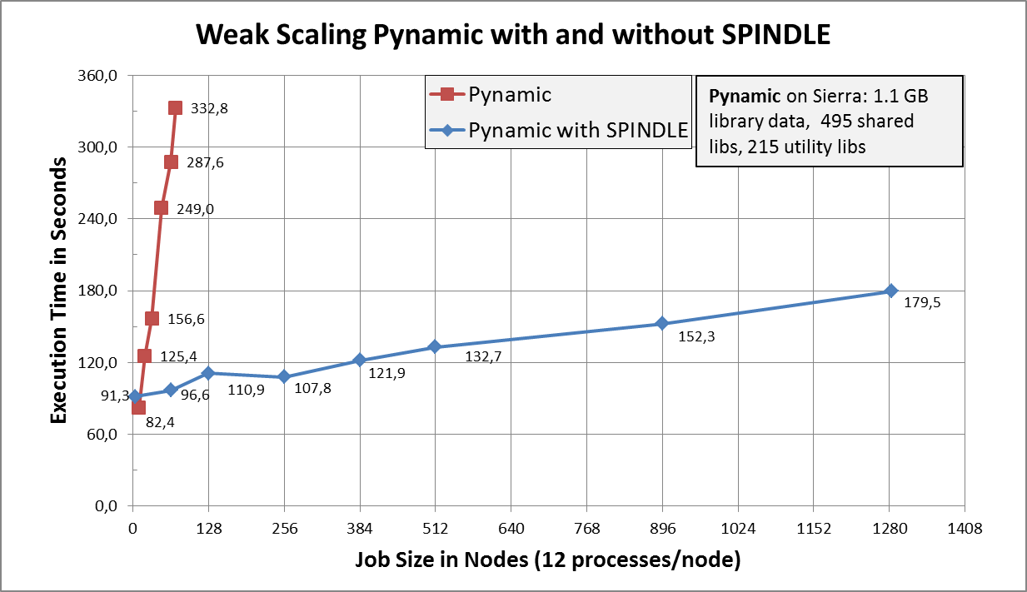
SPINDLE’s Performance

Slide 13
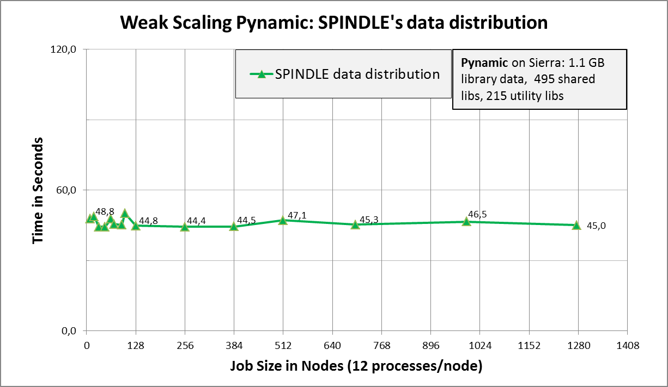
Constant Overhead of SPINDLE’s Data Distribution

Slide 14
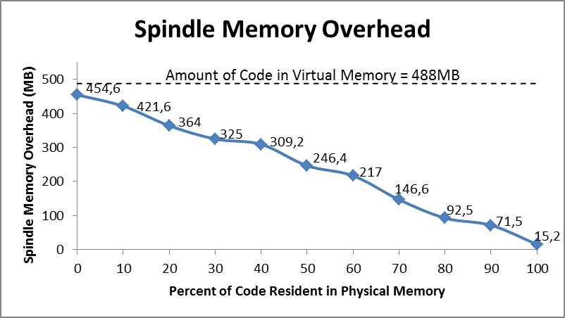
SPINDLE’s Memory Footprint
SPINDLE loads libraries to node-local RAM disk
All pages are in memory
No page reload during run-time (less OS-noise)
Process
without
memory
lib
SPINDLE
with
Remote file system
memory
used pages
unused pages (in RAM disk)
unused pages (on remote FS)
SPINDLE overhead: < 15 MB

Slide 15
Launching SPINDLE
SPINDLE wrapper call:
Executable is not modified
SPINDLE scalably loads:
Library files (from dependencies and dlopen)
Executable
Python .py/.pyc/.pyo files
exec/execv/execve/… call targets
Can follow forked processes
Integrated with LaunchMON
% spindle srun -n 512 myapp.exe <args>

Slide 16
Conclusion
Loading of dynamic applications at large scale
Limited scalability on large HPC systems
File access storm → denial-of-service attack to file system
SPINDLE
Extends dynamic loading by intercepting the dynamic loader through the auditing interface
Implements overlay network of file-cache servers for sharing location info, libraries, and Python files
Provides scalable and transparent environment for loading dynamic application
Evaluation of SPINDLE shows loading with no disruption for
Pynamic benchmark on Sierra up to 15,312 MPI tasks with constant overhead for SPINDLE data distribution

Slide 17
Availability & Outlook
Availability of SPINDLE
GitHub: https://github.com/hpc/Spindle
Documentation: https://scalability.llnl.gov/spindle
Licence: GNU Lesser General Public License (LGPL)
Build: Configure and Libtool, Test Environment
Version: 0.8
SPINDLE’s next steps
Porting, optimization and customization for broader range of HPC systems (e.g. IBM Blue Gene)
Tighter integration into various HPC system software (resource manager software systems)
SPINDLE’s is a stepping stone on the way to a massively parallel OS/runtime loading service for future exascale systems

Slide 18
Questions?
Matthew LeGendre
legendre1@llnl.gov

