Slide 1
Trace-Based Analysis of Task Dependency Effects on Performance
Daniel Lorenz
Jülich Supercomputing Centre
CScADS Tools Workshop
Madison, Wisconsin

Slide 2
Introduction
Tasks provide automatic scheduling and load-balancing
Profiling can be used to identify tasks of inappropriate size
  Too small tasks create large management overhead
Task dependencies can have effects that
  Create performance loss
  Execution time profile might provide too little information to understand the reasons

Slide 3
Task dependency case 1
Task 1
T
T
T
Thread 1
T
Task 2
T
T
Thread 2
T
T
Task 3
T
Thread 3
T
T
T
Task 4
Thread 4
Critical path determines runtime
  Execution time of the critical path much larger than average execution time of all threads.
  Execution time profile is perfectly balanced

Slide 4
Task dependency case 1 (possible improvements)
Task 1
T
T
T
Thread 1
T
Task 2
T
T
Thread 2
T
T
Task 3
T
Thread 3
T
T
T
Task 4
Thread 4
Task 1
T
T
T
Thread 1
T
Task 2
T
T
Thread 2
T
T
Task 3
T
Thread 3
T
T
T
Task 4
Thread 4

Slide 5
Task dependency case 2
Suspension / Late start of critical path
  The critical path is suspended for a significant amount of time
  Execution time profile is perfectly balanced
T
T
T
T4
Thread 1
T
T
T
T3
Thread 2
T
T
T
T2
Thread 3
T
T
T
T1
Thread 4

Slide 6
Task dependency case 2 (optimal schedule)
T
T
T
T
Thread 1
T
T
T
T
Thread 2
T
T
T
T
Thread 3
T1
T2
T3
T4
Thread 4

Slide 7
Goal
Identify task dependency induced performance loss
  Analysis of the task dependency graph
Point to causes
Automatic search over full program run
Present the analysis result in a small high-level report
  Manual scan through large number of tasks (e.g., in a time-line view) is tedious
  The effects may be obscured by other task chains

Slide 8
Performance issue detection
Determine critical path
  Chain with the longest wall-clock time
Calculate ideal execution time
  Sum of execution time of all tasks divided by the number of threads
If critical path is not significantly longer than ideal execution time
  No problem
Else
  Suspension time on the critical path is always a problem
  Compare execution time of critical path with ideal execution time and determine imbalance

Slide 9
Bad scheduling
T
T
T
T4
Thread 1
T
T
T
T3
Thread 2
T
T
T
T2
Thread 3
T
T
T
T1
Thread 4
Critical path suspension time
Critical path profile
T1
T2
T3
T4
Critical path wallclock time
T1
T2
T3
T4
Ideal execution time
Critical path suspension time

Slide 10
Critical path imbalance
Thread 1
Thread 2
Thread 3
Thread 4
Critical path profile
Critical path
Ideal execution time
Imbalance impact

Slide 11
Complexity
Is the calculation possible with real world applications?
  Maybe billions of tasks
  Reasonable runtime
  Memory requirements
In theory, the runtime of the analysis is O( |Nodes| + |Edges| )
It boils down to the complexity of the dependency graph

Slide 12
Assumptions
Tasks to not migrate to other processes
  Migration between threads of the same process are fine
  We can analyze each process independently
The trace of each process fit in a process’ memory
  Otherwise, flushes occurred making the measurement meaningless
  Too small tasks incur large task management overhead
It works if the graph is smaller than the trace

Slide 13
The task dependency graph (Basic idea)
A task is represented by a node
A dependency between two tasks A and B is represented by a edge
  B can only execute after A
Store execution time of a task in its node.
Store suspension time in the edge
  Difference between the time when the dependency of B are complete and when B starts execution
A
Thread 1
A
B
B
Thread 2
suspension time

Slide 14
Task suspension
A task may be suspended to wait on the completion on other tasks
If a task A is suspended, represent it by two nodes A1, A2
  Connect them by a dependency edge containing the suspension time
A
A
Thread 1
B
Thread 2
A1
A2
B

Slide 15
Task creation
A task can not start execution before it was created
  Add dependency between creator and created task
  Store offset in the edge, too
A
Thread 1
B
Thread 2
offset
suspension time
A
offset=2s
suspension=1s
B

Slide 16
Graph size
|Edges| < 2 |Nodes| in OpenMP 3.0
  Maximum 1 incoming creation edge or 1 incoming sequential edge per node
  Max. 1 outgoing wait dependency edge per node in OpenMP 3
At least 3 events per node in OTF2 (Open Trace Format 2)
  Enter
  Exit
  Switch
Many other events in the trace that are ignored
|Nodes| + |Edges| < |Events|

Slide 17
Presentation ideas
Output on task instance level is too detailed.
  Output information at an abstract level
  Map to source code
Goal: Add information to a profile

Slide 18
Execution time profile
  Aggregates statistics for all visits of a code region / task region
  Does not show that T1 and T2 are the important tasks to improve
time
T T1 T2
Execution time
T
T
T2
Thread 2
T
T
T1
Thread 1

Slide 19
Profile with critical path execution time
  Add the time spent on the critical path
  Shows that T1 and T2 are the limiting tasks
  But where does the wall clock time come from if the critical path is so short?
time
T T1 T2
Execution time
Critical path execution time
T
T
T2
Thread 2
T
T
T1
Thread 1

Slide 20
Profile with critical path suspension time
  Add the critical path suspension time to T1
  Blame T for the time it delays the execution of the critical path
time
T T1 T2
Execution time
Critical path execution time
Critical path suspension time
Critical path delaying time
T
T
T2
Thread 2
T
T
T1
Thread 1

Slide 21
Execution time profile
  The execution time does not provide the right hint
  What causes the idle time?
time
T T1 T2
T1
T
T
Execution time
Idle time
T
T2
T
T
T
T2

Slide 22
Profile with critical path execution time
  Adding the critical path metric shows which tasks determine the execution time much better.
time
T T1 T2
T1
T
T
Execution time
Idle time
Critical path execution time
T
T2
T
T
T
T2

Slide 23
Profile with imbalance impact
  The imbalance impact pin points where to optimize
  Show optimization potential
time
T T1 T2
T1
T
T
Execution time
Idle time
Critical path execution time
Imbalance impact
T
T2
T
T
T
T2

Slide 24
How to tell task instances apart?
The profile aggregates all tasks of the same source code region.
Sometimes all tasks stem from the same region, but behave different
  Caused by different internal execution path
  Can be distinguished in a profile by providing
    Task-internal call-path data
    Parameter data
T
T
T
T
T
T
T
T
T
T
T
T

Slide 25
Tell critical path imbalance impact apart
  Example task with conditional exection of foo or bar
  The total sum tells us that there is some imbalance caused by T, but how?
time
#pragma omp task // T
{
if (condition) foo();
else bar();
}
T
T
T
Execution time
Idle time
Critical path execution time
Imbalance impact
T
bar
T
T
T
bar

Slide 26
Tell critical path imbalance impact apart
  T/foo does not contribute to the critical path
  The execution path through T/bar creates the long tasks and the imbalance
time
T T/foo T/bar
T
T
Execution time
Idle time
Critical path execution time
Imbalance impact
T
bar
T
T
T
bar

Slide 27
Tell critical path suspension apart
time
  The sum of all tasks T tells that
    Some instances are part of the critical path
    The critical path is delayed by instances of T
    The delayed tasks are instances of T
T
Execution time
Critical path execution time
Critical path suspension time
Critical path delaying time
T
T
T
Thread 2
T
T
T
Thread 1

Slide 28
Tell critical path suspension apart
time
  The sum of all tasks T tells that
    Some instances are part of the critical path
    The critical path is delayed by instances of T
    The waiting delayed tasks are instances of T
  Separating the execution path reveals which tasks.
T T/foo T/bar
Execution time
Critical path execution time
Critical path suspension time
Critical path delaying time
T
T
T
Thread 2
T
T
T
Thread 1

Slide 29
Current status
Prototypical implementation by Youssef Hatem
  Graph generation and analysis
  Outputs dependency graph as intermediate result in CUBE format
  Implementation produce more vertices and edges
    Task creation divides the creator task in two nodes
Complexity tests with BOTS benchmark suite
  Preliminary results
Missing
  Mapping to call-path profile

Slide 30
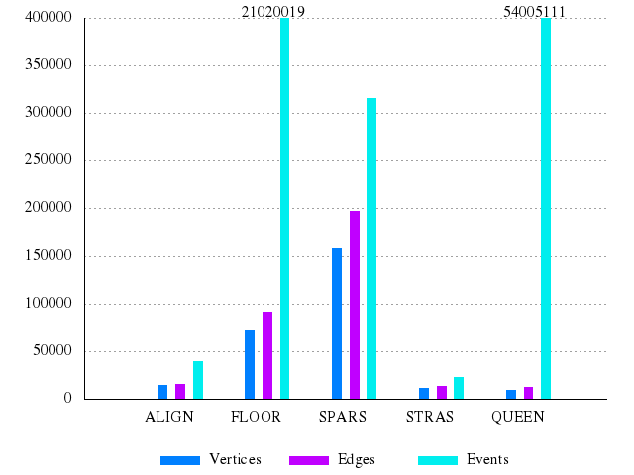
Preliminary: Event, vertices and edge count
Figure from Youssef Hatem: “Critical pat Analysis of Parallel Applications Using OpenMP Tasks”

Slide 31
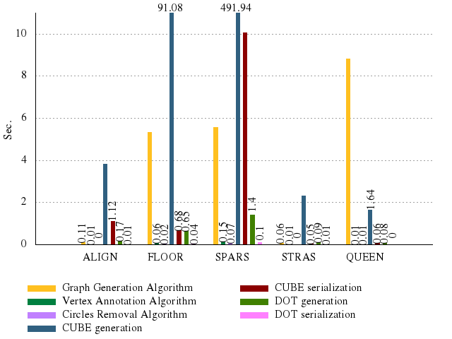
Preliminary: Analysis time
Figure from Youssef Hatem: “Critical pat Analysis of Parallel Applications Using OpenMP Tasks”

Slide 32
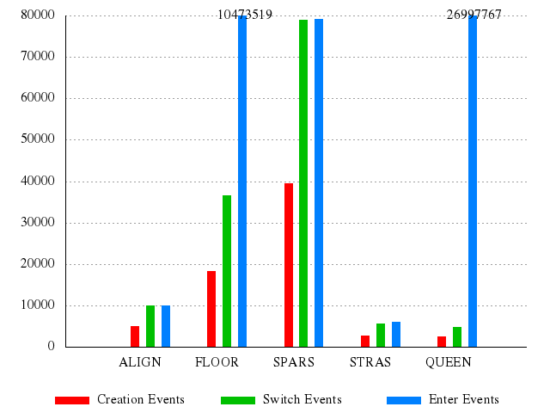
Preliminary: Number of events
Figure from Youssef Hatem: “Critical pat Analysis of Parallel Applications Using OpenMP Tasks”

Slide 33
Thanks for your attention

