Slide 1
Using Dyninst for Program Binary Analysis and Instrumentation
Emily Jacobson
Notes:
Ideal structure:
1. Start off conveying the purpose of the talk, which is:
to show how analysis goals can be accomplished through Dyninst’s ability to instrument program binaries.
illustrate it all with a compelling example
-highlight Dyninst’s components and how to use their functionality
-highlight Dyninst’s main abstractions and how to use them

Slide 2
No Source Code — No Problem
Executables
With Dyninst we can:
Find (stripped) code
  in program binaries
  in live processes
Analyze code
  functions
  control-flow-graphs
  loop, dominator analyses
Instrument code
  statically (rewrite binary)
  dynamically (instrument live process)
a.out
prog.exe
Libraries
lib.so
lib.dll
Live Process
Executable
Library 1
…
Library N

Slide 3
Choice of Static vs. Dynamic Instrumentation
Static Rewriting | Dynamic Instrumentation
Amortize parsing and instrumentation time. | Execute instrumentation at a particular time (oneTimeCode).
Potential to generate more efficient modified binaries. | Insert and remove instrumentation at run time.
3rd party response to runtime events | 1st party response to runtime events
Notes:
Delete candidate?

Slide 4
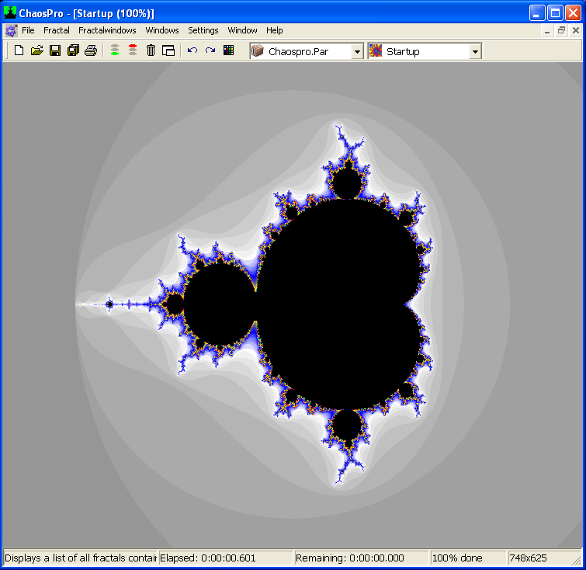
Example Dyninst Program
Find memory leaks
  Add printfs to malloc, free
  Stackwalk malloc calls that are not freed
ChaosPro ver 3.1

Slide 5
Dyninst Components
Analysis
Requests
Stack Walk
Requests
Instrumentation
Requests
Symbol Table Parser
(SymtabAPI)
Stack Walker
(Stackwalker-API)
Instrumenter
Code Parser
(ParsingAPI
Binary Code
Instruction Decoder
(Instruction-API)
Process Controller
(ProcControl-API)
Code Generator

Slide 6
Process Control
Several supported OS’s
Process Controller
Linux
Windows

Slide 7
Process Control
Several supported OS’s
Broad functionality
  Attach/create process
  Monitor process status changes
  Callbacks for fork/exec/exit
  Mutatee operations: malloc, load library, inferior RPC
Uses debugger interface
Analyst Program
(Mutator)
Dyninst Library
Debugger Interface
Monitored Process
(Mutatee)
Process Controller
Dyninst Runtime Lib

Slide 8

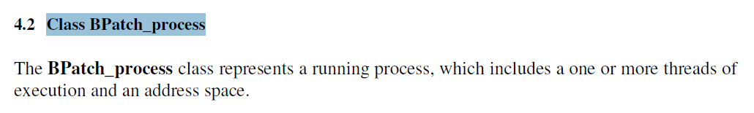
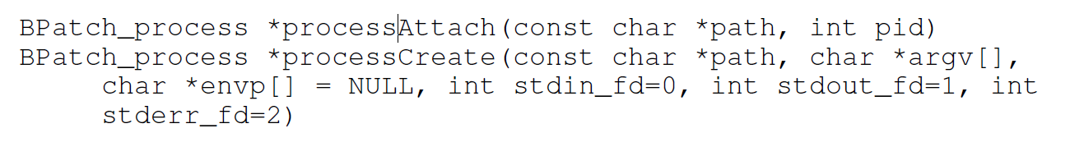
Dyninst’s Process Interface
http://paradyn.org/html/manuals.html
...
...

Slide 9
Example: Create a ChaosPro.exe Process
> mutator.exe C:\Chaos\ChaosPro.exe
BPatch bpatch;
static void exitCallback(BPatch_thread*,BPatch_exitType) {
printf(“About to exit\n”);
}
int main(int argc, char *argv[]) {
if (argc < 2) {
fprintf(stderr, "Usage: %s prog_filename\n", argv[0]);
return 1;
}
BPatch_process *proc = bpatch.processCreate( argv[1] , argv+1 );
bpatch.registerExitCallback( exitCallback );
proc->continueExecution();
while ( ! proc->isTerminated() )
bpatch.waitForStatusChange();
return 0;
}
Notes:
Questions?

Slide 10
Unified Abstractions
Add/remove instrumentation, lookups by address, allocate variables in mutatee
BPatch_addressSpace
BPatch_binaryEdit
BPatch_process
write file
Live Process
Process state, threads, one-time instrument-ation
a.out
a.out
libc.so
libc.so

Slide 11
Symbol Table Parsing
Where are malloc, free?
Mutator
Symbol Table Parser
Stack Walker
Instrumenter
Dyninst Library
Code Parser
Instruction Decoder
Process Controller
Code Generator
Mutatee
chaospro.exe
msvcrt.dll
Runtime Lib

Slide 12
Symbol Table Parsing
Symbol
Address
Size
PE
func1
0x0804cc84
100
Symbol Table Parser
variable1
0x0804cd00
4
ELF
func2
0x0804cd1d
500
XCOFF
Type
Information
Program
Headers
Relocations
Mutatee
Symbol
Versions
chaospro.exe
Section
Headers
Exception
Information
Local variable
Information
msvcrt.dll
Section
Data
Where are malloc, free?
Shared Object
Dependencies
Symbols
Runtime Lib
Line Number
Information
Dynamic
Segment
Information

Slide 13
Example: Find malloc
int main(int argc, char *argv[])
{
...
BPatch_image* image = proc->getImage();
BPatch_module* libc = image->findModule( “msvcrt” );
vector< BPatch_function* > * funcs =
libc->findFunction( “malloc” );
BPatch_function * bp_malloc = (*funcs)[0];
Address start = bp_malloc->getBaseAddr();
Address size = bp_malloc->getSize();
printf( “malloc: [%x %x]\n",
start , start + size );
...
}
Mutator
Dyninst Library
Mutatee
chaospro.exe
msvcrt.dll
Runtime Lib
Notes:
Questions?

Slide 14
Decoding and Parsing of Binary Code
Get parameters, return values for malloc, free
Mutator
Symbol Table Parser
Stack Walker
Instrumenter
Dyninst Library
Code Parser
Instruction Decoder
Process Controller
Code Generator
Mutatee
chaospro.exe
msvcrt.dll
Runtime Lib

Slide 15
Instruction Decoding
IA32
Abstract Syntax Tree
mov eax -> [ebx * 4 + ecx]
AMD64
mov
eax
[ebx * 4 + ecx]
POWER
Instruction Decoder
deref
Mutatee
add
8b 04 99 20 e9 3d e0 09 e8 68 c0 45 be 79 5e 80 89 08 27 c0 73
1c 88 48 6a d8 6a d0 56 4b fe 92 57 af 40 0c b6 f2 64 32 f5 07
mult
ecx
57 af 40 0c b6 f2 64 32 f5 07 b6 66 21 0c 85 a5 94 2b 20 fd 5b
ebx
4

Slide 16
Parsing
Parse-time analyses:
IA32
  Identify basic blocks, functions
  Builds control-flow graph
  Operate on stripped code, but use symbol information opportunistically
AMD64
Code Parser
POWER
Instruction Decoder
Mutatee
mov eax -> [ebx * 4 + ecx]
8b 04 99 20 e9 3d e0 09 e8 68 c0 45 be 79 5e 80 89 08 27 c0 73
mov
eax
[ebx * 4 + ecx]
deref
1c 88 48 6a d8 6a d0 56 4b fe 92 57 af 40 0c b6 f2 64 32 f5 07
add
mult
ecx
ebx
4
57 af 40 0c b6 f2 64 32 f5 07 b6 66 21 0c 85 a5 94 2b 20 fd 5b

Slide 17
Binary Code Parsing
chaospro.exe
Task: instrument malloc at its entry and exit points, instrument free at its entry point
Subtask: find malloc and parse it
Process Controller
Symbol Table Parser
msvcrt.dll
malloc 77C2C407
free 77C2C21B
atoi 77C1BE7B
strcpy 77C46030
memmove 77C472B0
Code Parser
Mutatee
84 04 99 20 e9 3d e0 09 e8 68 c0 45 be 79 5e 80 89 08 27 c0 73
Instruction Decoder
mov eax -> [ebx * 4 + ecx]
1c 88 48 6a d8 6a d0 56 4b fe 92 57 af 40 0c b6 f2 64 32 f5 07
mov
eax
[ebx * 4 + ecx]
deref
add
57 af 40 0c b6 f2 64 32 f5 07 b6 66 21 0c 85 a5 94 2b 20 fd 5b
mult
ecx
ebx
4

Slide 18
Control Flow Traversal Parsing
Function symbols may be sparse
  Executables must provide only one function address
  Libraries provide symbols for exported functions
Parsing finds additional functions by following call edges
_start [80483b0 80483fa]
_init [8048354 804836b]
_fini [8048580 804859c]
main [8048480 80484cf]
targ3d4 [80483d4 80483fa]
targ400 [8048400 804843e]
targ440 [8048440 8048468]

Slide 19
Control Flow Graph
Graph elements:
  BPatch_function
  BPatch_basicBlock
  BPatch_edge
Instrumentation points:
  BPatch_point
E
E
E
C
R
C
R
R
R
Address pointAddr;
BPatch_procedureLocation type;
enum { BPatch_entry,
BPatch_exit,
BPatch_subroutine,
BPatch_address }

Slide 20
Example: Find malloc’s Exit Points
malloc
Parsing is triggered automatically as needed
E
E
E
C
R
C
R
R
R
Mutatee
vector< BPatch_function * > * funcs;
funcs = bp_image->getProcedures();
funcs = bp_image->findFunction(“malloc”);
chaospro.exe
msvcrt.dll
kernel32.dll

Slide 21
Example: Find malloc’s Exit Points
malloc
Parsing is triggered automatically as needed
E
E
E
C
R
C
R
R
R
Mutatee
vector< BPatch_function * > * funcs;
funcs = bp_image->findFunction(“malloc”);
funcs = libc_mod->findFunction(“malloc”);
chaospro.exe
msvcrt.dll
kernel32.dll

Slide 22
Example: Find malloc’s Exit Points
malloc
E
E
E
C
R
C
R
R
R
Mutatee
BPatch_function * bp_malloc = (*funcs)[0];
vector< BPatch_point* > * points =
BPatch_entry
bp_malloc->findPoints BPatch_subroutine ;
BPatch_exit
chaospro.exe
msvcrt.dll
kernel32.dll
Notes:
Questions?

Slide 23
Instrumentation (at last!)
Mutator
Symbol Table Parser
Stack Walker
Instrumenter
Dyninst Library
Code Parser
Instruction Decoder
Process Controller
Code Generator
Mutatee
chaospro.exe
msvcrt.dll
Runtime Lib

Slide 24
Specifying Instrumentation Requests
Abstract Syntax Tree
Snippet
what
Instrumenter
Instrumentation
Requests
Instrument-
ation Points
Code Generator
where
R
R

Slide 25
BPatch_Snippet Subclasses
BPatch_sequence( vector < BPatch_Snippet*> items )
BPatch_variableExpr()
int value
BPatch_constExpr char* value
void* value
BPatch_ifExpr( BPatch_boolExpr condition,
BPatch_Snippet then_clause,
BPatch_Snippet else_clause )
BPatch_funcCallExpr( BPatch_function * func,
vector< BPatch_Snippet* > args )
BPatch_paramExpr( int param_number )
BPatch_retExpr()

Slide 26
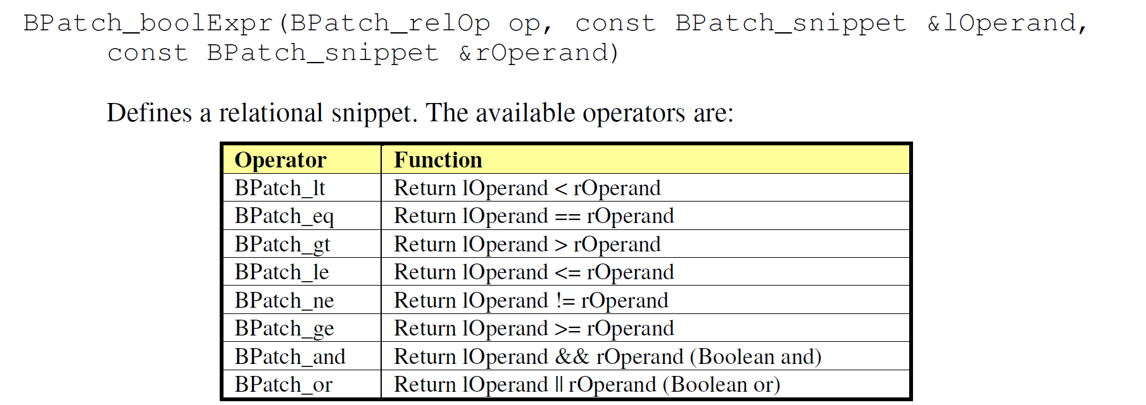
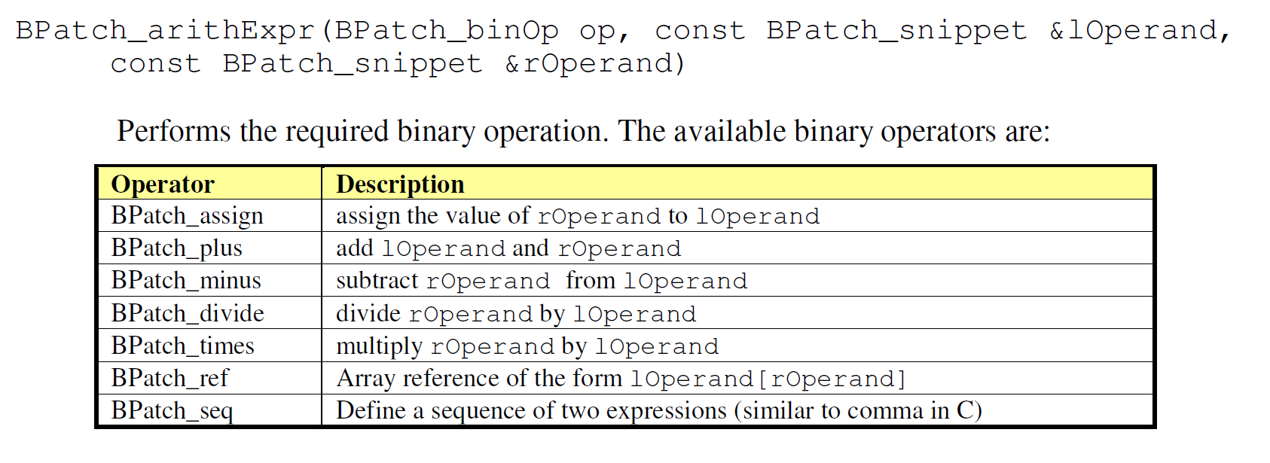
BPatch_Snippet Classes

Slide 27
Example: Forming printf Snippet
printf( “free(%x)\n” , arg0 );
BPatch_funcCallExpr ( BPatch_function * func,
vector< BPatch_Snippet* > args )
free(ptr)
E
BPatch_funcCallExpr
Bpatch_function bp_printf
vector
BPatch_constExpr
“free(%x)\n”
BPatch_paramExpr arg0(0)

Slide 28
Example: Instrument free w/ call to printf
BPatch_function * bp_free;
vector< BPatch_point * > entryPoints;
...
BPatch_constExpr arg0 ( “free(%x)\n” );
BPatch_paramExpr arg1 (0);
vector< BPatch_snippet * > printf_args;
printf_args.push_back( & arg0 );
printf_args.push_back( & arg1 );
BPatch_funcCallExpr callPrintf( *bp_printf,
printfArgs );
bpatch.beginInsertionSet();
for ( int idx =0;
idx < entryPoints.size();
idx++ )
proc->insertSnippet( callPrintf,
*entryPoints[idx] );
bpatch.finalizeInsertionSet();
BPatch_funcCallExpr
bp_printf
vector
BPatch_constExpr
“free(%x)\n”
BPatch_paramExpr arg0(0)
free(ptr)
E
Notes:
Questions?

Slide 29
Using Variables
malloc instrumentation: save argument in a variable
Find / create variable
  bp_image->findVariable(“global1”);
  bp_proc->malloc(bp_image->findType(“int”));
Initialization instrumentation
  e.g., assignment at entry point of main
Manipulation instrumentation
  e.g., arithmetic assignment expression
Gather / print out values
  e.g., through callback instrumentation

Slide 30
Example: Instrumenting malloc
void * malloc ( size_t size )
{
MALLOC_ARG = size;
...
if (MALLOC_ARG > 1000)
printf(“%x = malloc(%x)\n”,
retnValue,
MALLOC_ARG);
}
malloc
E
R
R
BPatch_arithExpr
BPatch_assign
MALLOC_ARG
BPatch_constExpr
1

Slide 31
Example: Instrumenting malloc
void * malloc ( size_t size )
{
MALLOC_ARG = size;
...
if (MALLOC_ARG > 100)
printf(“%x = malloc(%x)\n”,
retnValue,
MALLOC_ARG);
}
malloc
E
R
BPatch_ifExpr
R
Bpatch_boolExpr
BPatch_funcCallExpr
vector
BPatch_gt
BPatch_constExpr(100)
BPatch_constExpr
MALLOC_ARG
BPatch_function
bp_printf
“%x = malloc(.)\n”
BPatch_retExpr retnValue
Notes:
Questions?

Slide 32
Generating the Instrumentation Code
BPatch_funcCallExpr
Instrumenter
Code Generator
IA32
bp_printf
vector
BPatch_constExpr
AMD64
“free(%x)\n”
BPatch_paramExpr arg0(0)
POWER
Instrumentation snippet
mov eax -> [ebx * 4 + ecx]
mov
eax
[ebx * 4 + ecx]
deref
add
mult
ecx
ebx
4
Code at the instrumented point

Slide 33
Stack Walking
Mutator
Symbol Table Parser
Stack Walker
Instrumenter
Dyninst Library
Code Parser
Instruction Decoder
Process Controller
Code Generator
Mutatee
chaospro.exe
msvcrt.dll
Runtime Lib

Slide 34
Example: Stack Walk of malloc Call
Callback triggers stackwalk
  BPatch_thread:: getCallStack(…)
Mutator
Stack Walker
Dyninst Library
malloc
Choose instrumentation point
  the exit points of malloc
Insert callback instrumentation
  use stopThreadExpr snippet
Mutatee
E
chaospro.exe
msvcrt.dll
Runtime Lib
R
R

Slide 35
Implementation Session
Code Coverage
Create a mutator that counts function invocations
See description of the lab at http://www.paradyn.org/tutorial/

