Slide 1
Gremlins’ the Sequel – the Horrors of Exascale
Judit Gimenez, BSC
Martin Schulz, LLNL
http://scalability.llnl.gov/
http://www.bsc.es/
LLNL-PRES-xxxxxx

Slide 2
How (not) to Build an Exascale Machine
Can we make a Petascale class machine behave like what we expect Exascale machines to look like?
Limit Resources (power, memory, network, I/O, …)
Increase compute/bandwidth ratios
Increase fault rates and lower MTBF rates
In short: release GREMLINs into a petascale machine
Goal: Emulation Platform for the Co-Design process
Evaluate proxy-apps and compare to baseline
Determine bounds of behaviors proxy apps can tolerate
Drive changes in proxy apps to counter-act exascale properties

Slide 3
How to Release GREMLINs onto your Machine
Techniques to force “bad” behavior on “good” systems
Target individual resources and artificially limit them
Using hardware techniques
Stealing resources by creating contention
Directly inject bad behavior through external events
Individual GREMLINs are implemented as modules
One effect at a time
Orthogonal to each other
Each GREMLIN has “knobs” to control behavior
The GREMLIN framework
Dynamic configuration and loading of individual GREMLINs
Ability to couple a range of “bad behaviors”
Transparent to system and (mostly) to applications

Slide 4
The Gremlin Architecture
Multi node job (e.g., MPI)
Applications
Applications
Applications
Measurement
Measurement
Measurement
GREMLIN Env.
GREMLIN Env.
GREMLIN Env.
Power GREMLIN
Power GREMLIN
Memory GREMLIN
Fault GREMLIN
Architecture
Architecture
Architecture
Rank 0
Rank 1
Rank N
GREMLIN
Control
Front end node

Slide 5
Broad Classes of GREMLINs
Power
Impact of changes in frequency/voltage
Impact of limits in available power per machine/rack/node/core
Memory
Restrictions in bandwidth
Reduction of cache size
Limitations of memory size
Resiliency
Injection of faults to understand impact of faults
Notification of “fake” faults to test recovery
Noise
Injection of controlled or random noise events
Crosscut summarizing the effects of previous GREMLINs

Slide 6
Broad Classes of GREMLINs
Power
Impact of changes in frequency/voltage
Impact of limits in available power per machine/rack/node/core
Memory
Restrictions in bandwidth
Reduction of cache size
Limitations of memory size
Resiliency
Injection of faults to understand impact of faults
Notification of “fake” faults to test recovery
Noise
Injection of controlled or random noise events
Crosscut summarizing the effects of previous GREMLINs

Slide 7
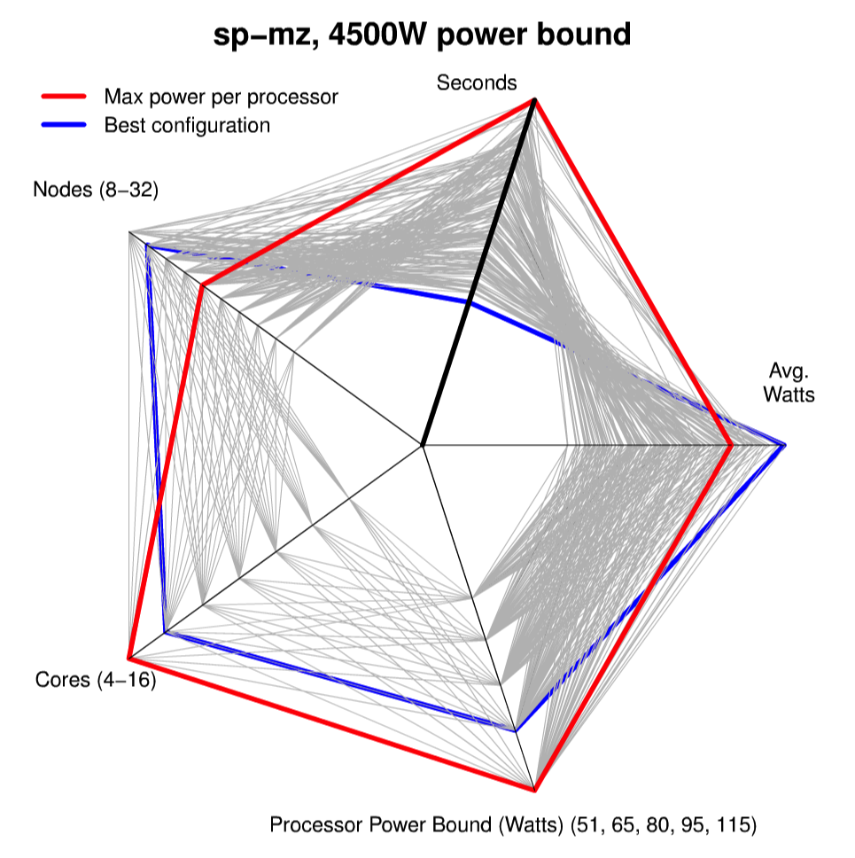
Results from the Power Gremlins
Using RAPL to install power caps
Exposes chip variations
Turns homogenous machines into inhomogeneous ones
Optimal configuration under a power cap
Widely differing performance
Application specific characteristics
Need for models

Slide 8
Update on Power Gremlin Infrastructure
Low-level infrastructure
Libmsr: user-level API to enable access to MSRs (incl. RAPL capping)
Msr-safe: kernel module to make MSR access “safe”
Current status
Support for Intel Sandy Bridge
More CPUs (incl. AMD) in progress
Code released on github: https://github.com/scalability-llnl/libmsr
Inclusion into RHEL pending
Deployed on TLCC cluster cab
Analysis update
Full system characterization (see Barry’s talk)
Application analysis in progress

Slide 9
Next Steps: Feeding the Gremlins After Midnight
Scheduling research
Find optimal configurations for each code
Balance processor inhomogeneity
Understand relationship to load balancing
Integration into FLUX
New Gremlins
Artificially introduce noise events
Network Gremlins
Limit network bandwidth or increase latency
Inject controlled cross traffic
Adaptation of the Gremlins to new programming models
Initially developed for MPI (using P^{n}MPI as base)
First new target: OmpSs

Slide 10
BSC Experiments with Gremlins
Gremlins integrated with
OmpSs runtime
Extrae instrumentation (online mode)
Analysis of Gremlins’ impact
Living with Gremlins! Measure applications’ sensitivity
Growing our Gremlins! uniform vs. non-uniform populations
Have Gremlins side-effects?
Do they increase/affect variability?
Should not affect other resources
First results
Up to now playing with memory Gremlins

Slide 11
Integrating Gremlins in OmpSs runtime system
Gremlins launched at runtime initialization but remain transparent
Each gremlin thread is exclusively pinned on one core
These processors then become inaccessible by the runtime
Runtime parameters can be used to
enable/disable gremlins,
define number of gremlin threads, resource type
how much of that resource a single gremlin thread should use
Marc Casas

Slide 12
Current Work
Identify sensitive tasks
Classify how sensitive they are
Match them with tasks that can be run concurrently and are less sensitive to the respective resource type
Implement smart Scheduler in OmpSs
Modify OmpSs scheduler to identify resource sensitive tasks with the use of gremlin threads
Implement a scheduler that takes this information into account when scheduling tasks for execution

Slide 13
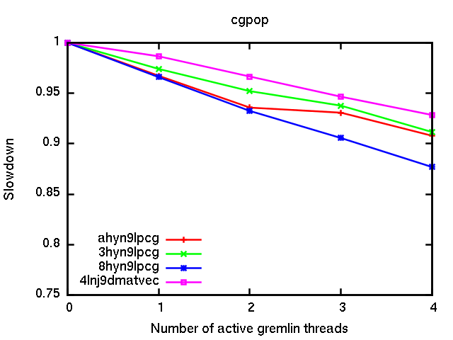
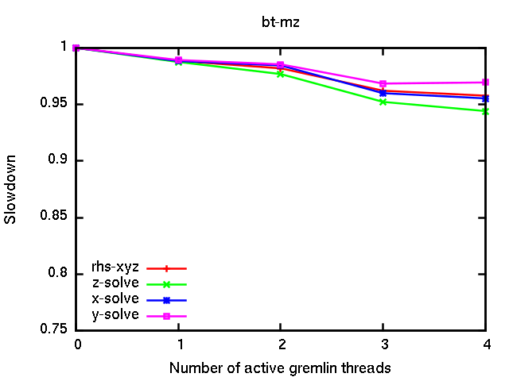
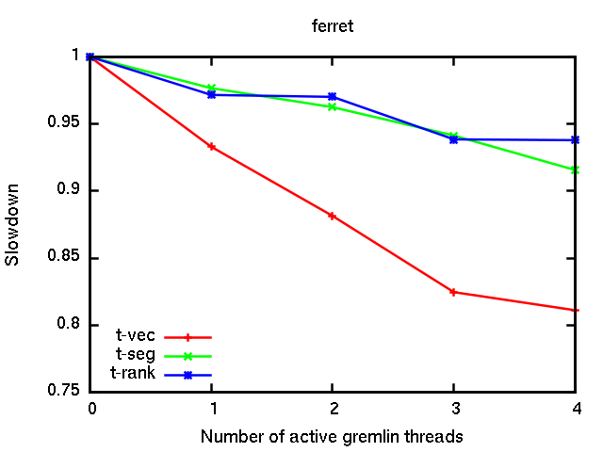
Results L3 cache capacity interference
0 gremlin - 20MB
1 gremlin - 15MB
2 gremlin - 12MB
3 gremlin - 7MB
4 gremlin - 4MB

Slide 14
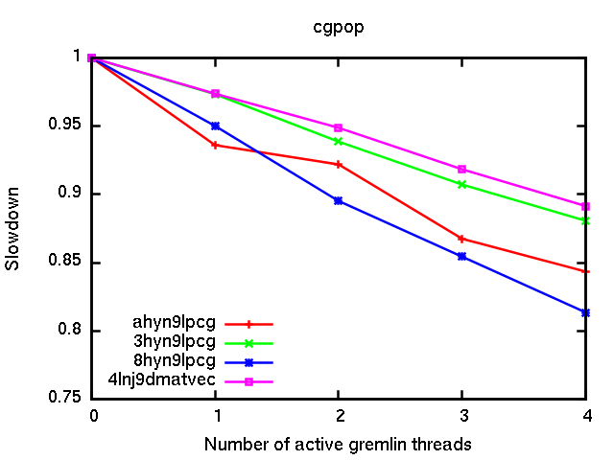
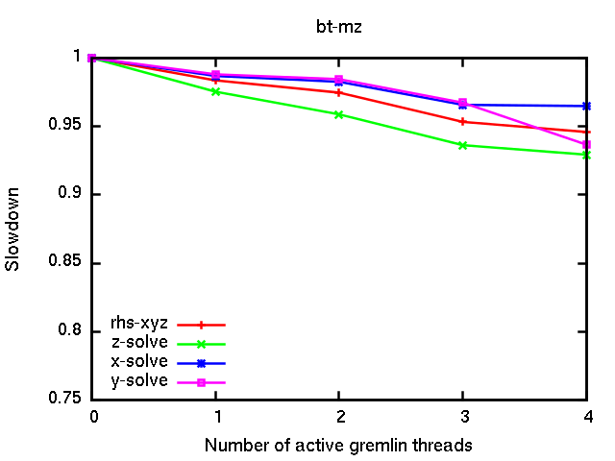
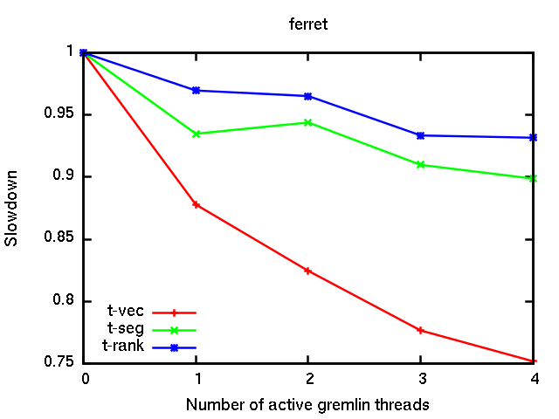
Results with memory BW interference
0 gremlin - 40GB/s
1 gremlin - 37.2GB/s
2 gremlin - 34.3GB/s
3 gremlin - 31.5GB/s
4 gremlin - 28.7GB/s

Slide 15
CGPOP sensitivity LLC cache size and bw
Without gremlins
Limiting size (4MB)
Limiting bandwidth (28.7 GB/s)

Slide 16
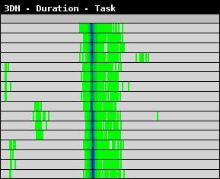
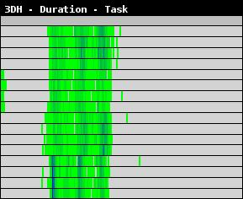
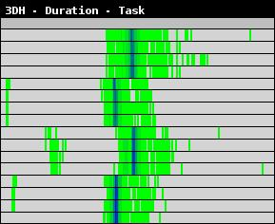
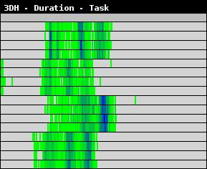
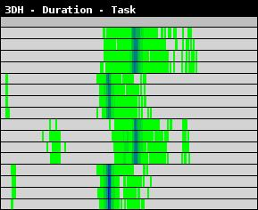
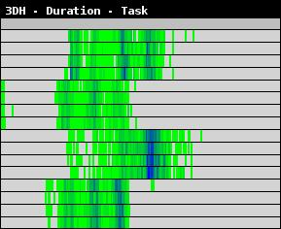
CGPOP sensitivity LLC cache – variability / unbalance
4lnj8dmatvec
8hyn9lpcg
Limiting size (4MB)
Limiting bandwidth (28.7 GB/s)

Slide 17
CGPOP sensitivity LLC cache – unbalance along time
8hyn9lpcg
Limiting size (4MB)
Limiting bandwidth (28.7 GB/s)

Slide 18
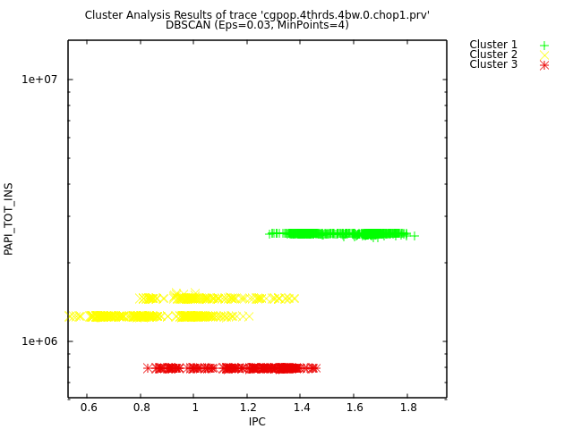
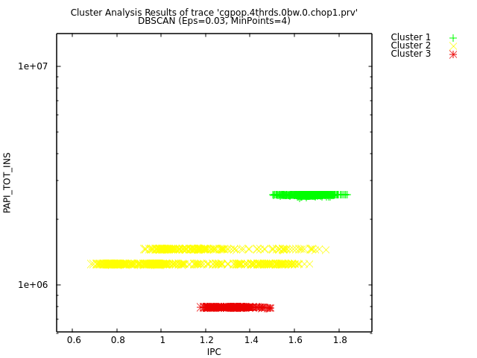
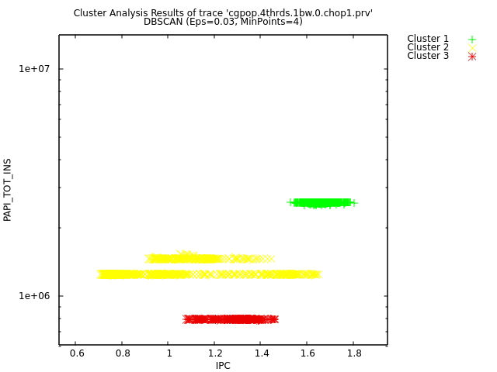
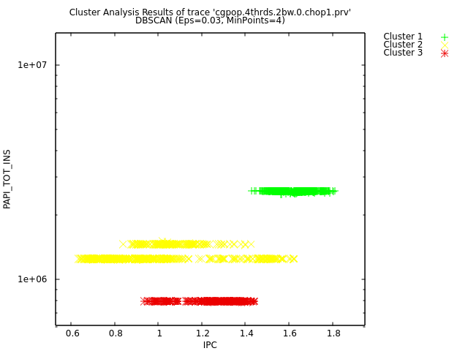
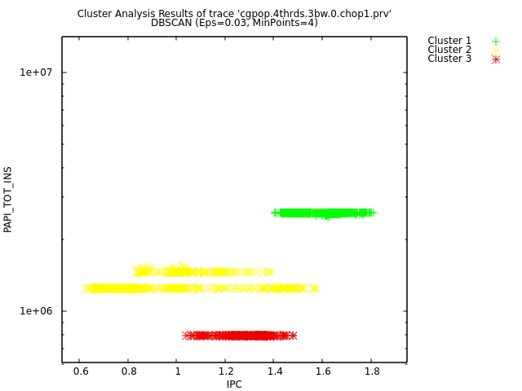
CGPOP sensitivity LLC cache – tracking evolution
Limiting bandwidth
4lnj8dmatvec
3hyn9lpcg
ahyn9lpcg
8hyn9lpcg

Slide 19
Integrating Gremlins in Extrae
Extrae online analysis mode
Based on MRNet
Gremlins API to activate them locally
All Gremlins launched at initialization time
First experiments with LLC cache size gremlins
Periodic increase of Gremlins
Unbalanced steal of resources

Slide 20
LULESH sensitivity to LLC cache size
Can we extract insight from chaos?
Unbalanced Gremlins creation

Slide 21
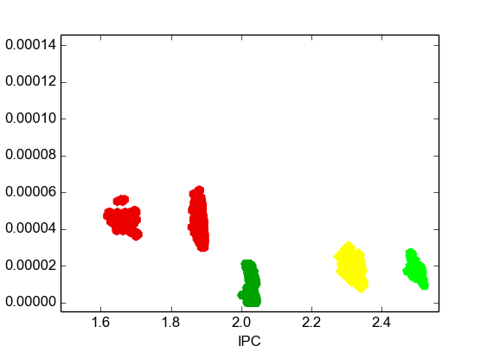
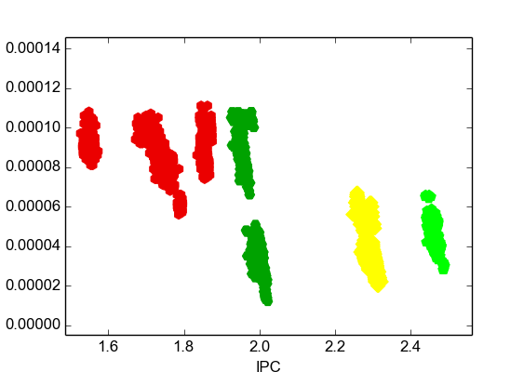
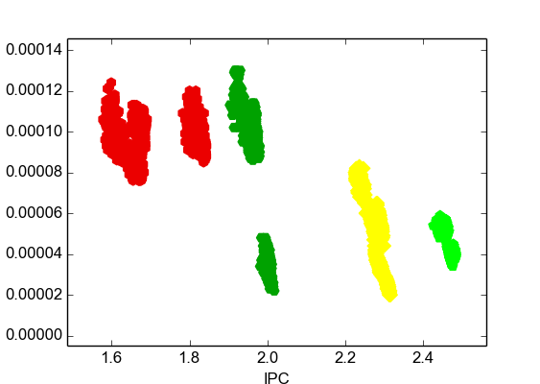
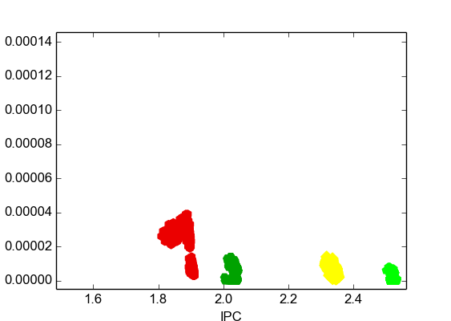
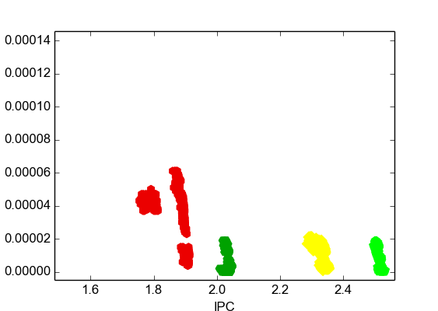
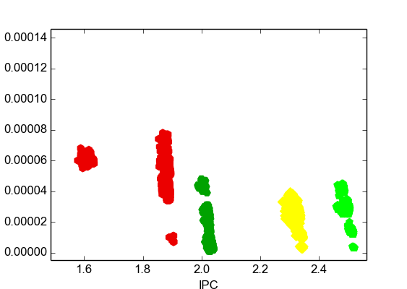
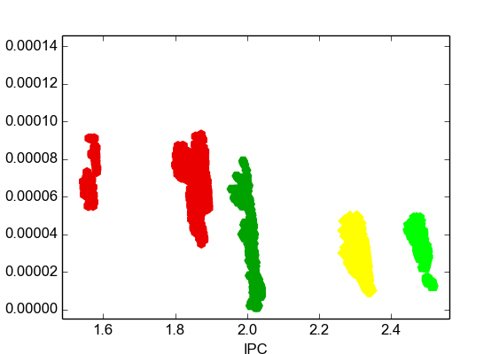
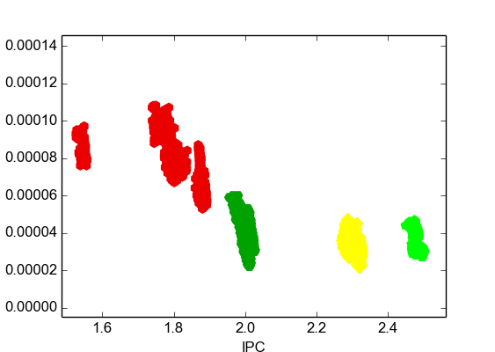
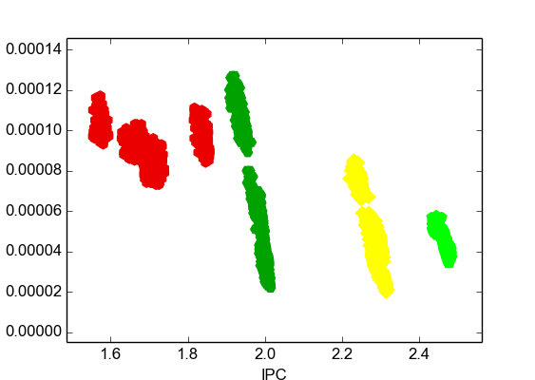
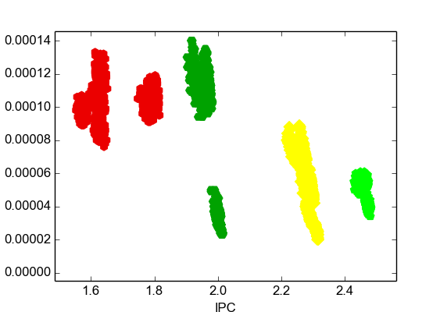
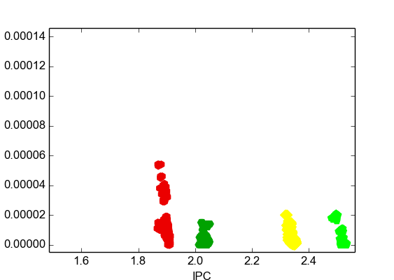
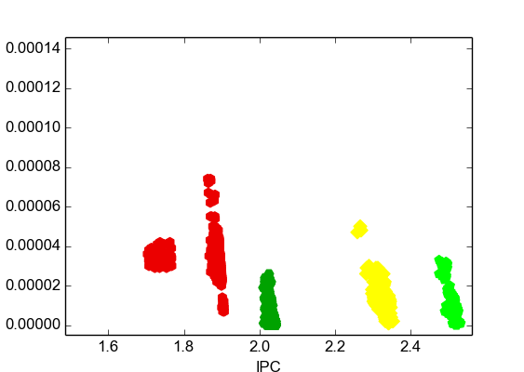
LULESH sensitivity to LLC cache size – tracking evol.
L3/instr. ratio

Slide 22
Conclusions
Different regions show different sensitivity to resource reductions
Asynchrony affects actual sharing of resources
Today happens without control → variability
Detailed analysis detects increases on variability and potential non-uniform impact

