Slide 1
Binary Code is Not Easy
Xiaozhu Meng, Emily Gember-Jacobson, and Bill Williams

Slide 2
Three parsing stages
Binary file:
Code Discovery
xchg %eax,%ecx
fdiv %st(3),%st
jmp *-0xf(%esi)
add %edi,%ebp
jmp *-0x39(%ebp)
mov 0xc(%esi),%eax
7a 77 0e 20 e9 3d e0 09 e8 68 c0 45 be 79 5e 80 89 08 27 c0 73 1c 88 48 6a d8 6a d0 56 4b fe 92 57 af 40 0c b6 f2 64 32 f5 07 b6 66 21 0c 85 a5 94 2b 20 fd 5b 95 e7 c2 42 3d f0 2d 7a 77 0e 20 e9 3d e0 09 e8 68 c0 45 be 79 5e 80 37 1b 2f b9
CFG Construction
foo:
bar:
CFG Partitioning
2

Slide 3
Parsing approaches
Linear scan
Control flow (recursive) traversal
Speculative disassembly

Slide 4
Parsing approach: Linear scan
Decode instructions sequentially starting from a specific point
Easy to implement
Discovers almost all the instructions
Can confuse data with code
Can be confused about instruction alignment
Tools that use linear scan
GNU Objdump
IDA Pro
CodeSurfer/x86
BAP

Slide 5
Parsing approach: Control flow traversal
Decodes instructions start from known function entry points and follows control transfers of the program
Only looks at code and ignores data
Completeness depends on quality of indirect control flow analysis
Depends on gap parsing to find code not reachable by the traversal
Tools that use control flow traversal
Dyninst

Slide 6
Parsing approach: Speculative disassembly
Tries to decode instructions starting at every byte
Will not miss any instruction
Does not always find the actual start of an instruction
May confuse code with data
Tools that use speculative disassembly
Dyninst (gap parsing only)
OllyDebug
SecondWrite

Slide 7
Difficulties of accurate parsing
Binary file:
Code Discovery:
Code and data are mixed
Compiler may insert padding
Function symbols can be incomplete or missing
Instructions may overlap
Symbol table
address of foo: 0x4000
address of bar: 0x4040
.text
4000 <foo>:
…………
jmp %eax
data
…………
ret
xchg %eax %eax
4040 <bar>:
…………
call _abort
…………
jmp bar
7

Slide 8
Difficulties of accurate parsing
Binary file:
Code Discovery:
Code and data are mixed
Compiler may insert padding
Function symbols can be incomplete or missing
Instructions may overlap
Symbol table
address of foo: 0x4000
address of bar: 0x4040
.text
4000 <foo>:
…………
jmp %eax
CFG Construction:
Indirect control flow
Non-returning functions
Exception handling
data
…………
ret
xchg %eax %eax
4040 <bar>:
…………
call _abort
…………
jmp bar
8

Slide 9
Difficulties of accurate parsing
Binary file:
Code Discovery:
Code and data are mixed
Compiler may insert padding
Function symbols can be incomplete or missing
Instructions may overlap
Symbol table
address of foo: 0x4000
address of bar: 0x4040
.text
4000 <foo>:
…………
jmp %eax
CFG Construction:
Indirect control flow
Non-returning functions
Exception handling
data
…………
ret
xchg %eax %eax
CFG Partitioning:
Binary functions are complex
Functions may share code
Function body may not be continuous
Functions do not always terminate in a return; sometimes they terminate in a jump (tail call) or a call instruction (non-returning function).
4040 <bar>:
…………
call _abort
…………
jmp bar
9

Slide 10
How well do other tools do?
Stage | Challenge | GNU Objdump | IDA Pro
Code Discovery | Code or data | 0/2 | 1/2
 | Missing symbols | recover 0/1227 false entry 0 | recover 608/1227 false entry 408
 | Overlapping instructions | 0/1 | 0/1
CFG Construction | Indirect control flow | 0/6 | 2/6
 | Non-returning functions | 0/2 | 1/2
CFG Partitioning | Functions sharing code | 0/1 | 0/1
 | Non-continuous functions | 0/1 | 0/1
 | Tail calls | 0/1 | 1/1
10

Slide 11
There is interaction between the parsing stages
Code Discovery
CFG Construction
CFG Partitioning
11

Slide 12
The ParseAPI approach
Code Discovery
Control flow (recursive) traversal
CFG Construction
CFG function representation model
CFG Partitioning
Challenge specific analyses
Entry point of foo
Entry point of bar
Intraprocedural edge
Interprocedural edge
12

Slide 13
ParseAPI’s mechanisms and status
Stage | Challenge | Our technique | ParseAPI Status
Code Discovery | Code or data | Control flow traversal | Done
 | Missing symbols | Probabilistic gap parsing | Integrating
 | Overlapping instructions | Control flow traversal | Done
CFG Construction | Indirect control flow | Backward slicing + Symbolic evaluation | Integrating
 | Non-returning functions | Might-ret analysis | Done
 | Exception handling | Leveraging debugging information | Limited
CFG Partitioning | Complex functions | CFG function representation model | Done
 | Tail calls | Stack analysis + CFG structure analysis | Prototyping
13

Slide 14
Challenge: Code or Data?
80b134e: call 8050760 <__i686.get_pc_thunk.bx>
80b1353: add $0x25025,%ebx
80b15e5: mov %ebx,%ecx
80b15e7: sub -0x24d88(%ebx,%eax,4),%ecx # [80b15f0+eax*4]
80b15ee: jmp *%ecx
Jump table data:
Entry | Address | Bytes | Data value
eax=0 | 80b15f0 | e0 4c 02 00 | 0x24ce0
eax=1 | 80b15f4 | 98 4a 02 00 | 0x24a98
eax=2 | 80b15f8 | a6 4a 02 00 | 0x24aa6
eax=3 | 80b15fc | b3 4a 02 00 | 0x24ab3
However, if the jump table data bytes are misinterpreted as code:
80b15f0: e0 4c loopne 80b163e
80b15f2: 02 00 add (%eax),%al
80b15f4: 98 cwtl
80b15f5: 4a dec %edx
80b15f6: 02 00 add (%eax),%al
80b15f8: a6 cmpsb %es:(%edi),%ds:(%esi)
80b15f9: 4a dec %edx
80b15fa: 02 00 add (%eax),%al
80b15fc: b3 4a mov $0x4a,%bl
80b15fe: 02 00 add (%eax),%al

Slide 15
Challenge: Overlapping instructions
3fe9e8: je 3fe9eb
3fe9ea: lock cmpxchg %ecx, 0x35b0(%ebx)
3fe9f2: jne 3ff740
Address 3fe9
e8 | e9 | ea | eb | ec | ed | ee | ef | f0 | f1 | f2 | ~ | f7
74 | 01 | f0 | 0f | b1 | 8b | b0 | 35 | 00 | 00 | 0f | .. | 00
je 3fe9eb |  | lock cmpxchg %ecx, 0x35b0(%ebx) |  |  |  |  |  |  |  | jne 3ff740
 |  |  | cmpxchg %ecx, 0x35b0(%ebx)
Bytes
In ParseAPI, overlapping instructions are in separate basic blocks that have the same predecessors and successors in the CFG.

Slide 16
Challenge: Indirect control flow
c8a42a: cmp $0xc,%dil
c8a42e: ja c8a518
c8a434: lea 0x31fd41(%rip),%r8
c8a43b: movzbl %dil,%edi
c8a43f: mov %rsi,%rbp
c8a442: movslq (%r8,%rdi,4),%rax
c8a446: add %rax,%r8
c8a449: jmpq *%r8
Backward slice on jmpq:
All instructions that calculate the jump targets

Slide 17
Challenge: Indirect control flow
c8a42a: cmp $0xc,%dil
c8a42e: ja c8a518
c8a434: lea 0x31fd41(%rip),%r8
c8a43b: movzbl %dil,%edi
c8a43f: mov %rsi,%rbp
c8a442: movslq (%r8,%rdi,4),%rax
c8a446: add %rax,%r8
c8a449: jmpq *%r8
Backward slice on jmpq
2. Symbolically evaluate the jump target
c8a42a and c8a42e:
dil = RDI and RDI ≤ 12
c8a434: r8; = rip + 31fd41
; = faa175
c8a43b: RDI ≤ 12
c8a442: rax = [r8 + rdi × 4]
; = [faa175 + RDI × 4]
c8a446: ; r8 = r8 + rax
; = faa175 + [faa175 + RDI × 4]
Variable | Symbolic value
rax
rdi
r8
[faa175 + RDI × 4]
RDI (RDI ≤ 12)
faa175 + [faa175 + RDI × 4]
faa175
<Offset base> + [<Table base> + <Table index> × <Table stride>]

Slide 18
Challenge: Indirect control flow
Variation and complexity of indirect control flow
Jump target formulas can involve 0 or more memory accesses
Variation of formula element
Table stride can vary; we have seen 2, 4 and 8
Table index can come from any register or a memory location
Offset base and table base may be computed by various instructions
Table index condition
Comparison and conditional jump instruction pair
Bit operation “and” : and 0x3,%rax implies rax ≤ 3
<Table base> ± <Table index> × <Table stride>
[<Table base> ± <Table index> × <Table stride>]
<Offset base> ± [<Table base> ± <Table index> × <Table stride>]

Slide 19
Challenge: Non-returning functions
Looks like the call is inside a loop

Slide 20
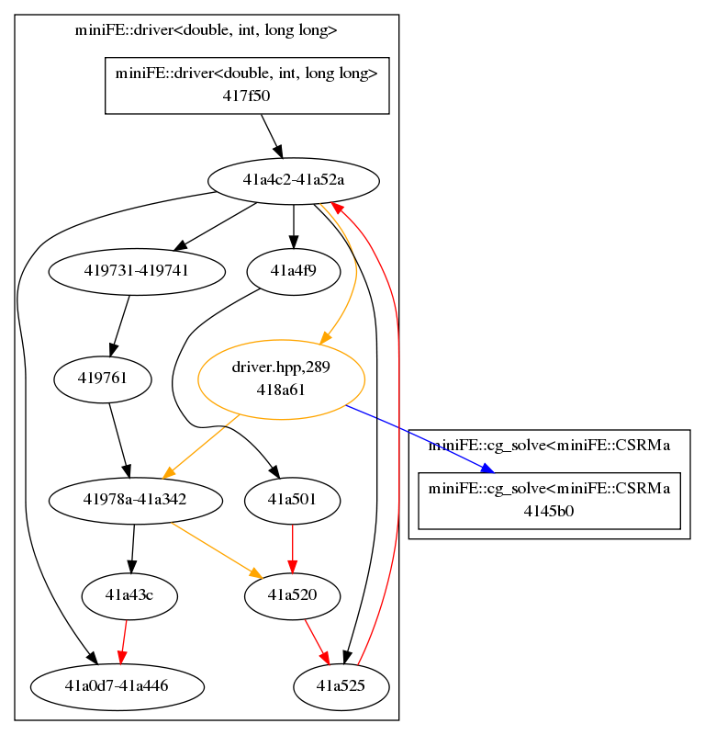
Challenge: Non-returning functions
CFG of the function when not considering non-returning functions
Intraprocedural edge not in loop
The loop is created by superficial call fall through edges
Intraprocedural edge in loop
Function call edge
Superficial call fall through edge

Slide 21
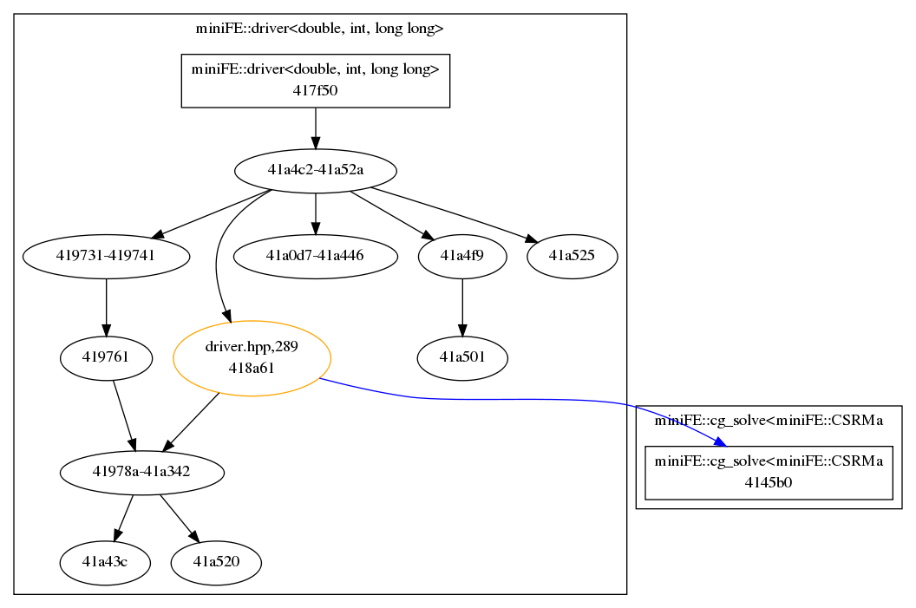
Challenge: Non-returning functions
CFG of the function
No loop
Intraprocedural edge
Function call edge

Slide 22
Might-ret analysis
Return status of a function can be "unknown", "might ret", or “does not ret"
Calculate a fix point for all functions
1. known funcs
2. reach ret
3. call
4. recursion
exit
_exit
abort
__f90_stop
fancy_abort
__stack_chk_fail
__assert_fail
ExitProcess
………
<foo>:
push %ebp
mov %esp,%ebp
sub $0x18,%esp
mov (%eax),%eax
leave
ret
<foo>:
…………
call <bar>
…………
<foo>: unknown
<bar>: unknown
bar’s ret status
unknown:
first analyze bar
might ret:
continue in foo
does not ret: stop
foo and bar do not ret
does not ret
might ret
Notes:
Alignment

Slide 23
Conclusions
This work was driven by our experiences with real binaries
We discussed the challenges in three parsing stages
We analyzed code examples in details and discussed how we address these challenges

Slide 24
Missing Symbols
Stripped binaries
Pattern matching
Probabilistic parsing

Slide 25
Indirect control flow
445755: 0x10(%rbx),%rax
445759: test %rax,%rax
44575c: je 4457c3
44575e: pop %rbx
44575f: pop %rbp
445760: mov %r12,%rdi
445763: pop %r12
445765: pop %r13
445767: pop %r14
445769: jmpq *%rax
Backward slice
Symbolic evaluation
Bound fact analysis
Get jump targets
Symbolic expression: jmpq [rbx+0x10]
Bound facts:
Calculate and check jump targets:
cannot find any candidate jump targets!

Slide 26
Complex functions
MECFG Model:
Entry of __write
38958db680 <__write>:
b680: cmpl $0x0,0x2b6fe9(%rip)
b687: jne 38958db699
38958db689 <__write_nocancel>:
b689: mov $0x1,%eax
…………………
b696: jae 38958db6c9
b698: retq
b699: sub $0x8,%rsp
…………………
b6c6: jae 38958db6c9
b6c8: retq
b6c9: mov 0x2b18d0(%rip),%rcx
…………………
b6dc: jmp 38958db6c8
Jump into another function!
Block1: [b680, b689)
Entry of __write
_nocancel
Block2: [b689, b698)
Block3: [b698, b699)
Block4: [b699, b6c8)
Block5: [b6c8, b6c9)
Block6: [b6c9, b6df)
__write: block 1,2,3,4,5,6
__write_nocancel: block 2,3

Slide 27
Challenge: Indirect control flow
c8a42a: cmp $0xc,%dil
c8a42e: ja c8a518
c8a434: lea 0x31fd41(%rip),%r8
c8a43b: movzbl %dil,%edi
c8a43f: mov %rsi,%rbp
c8a442: movslq (%r8,%rdi,4),%rax
c8a446: add %rax,%r8
c8a449: jmpq *%r8
Backward slice on jmpq
Symbolic evaluation
Bound fact analysis
Get jump targets
Jump target expression and condition:
jmpq [rdi*4+0xfaa17c]+0xfaa17c
rdi <= 0xc
rdi=0
faa17c: d4 02 ce ff
# -0x31fd2c
faa180: 27 ff ff ff
# -0x31fcec
faa184: 4d ff ff ff
# -0x31fcbc
jmpq c8a450
rdi=1
jmpq c8a490
rdi=2
jmpq c8a4c0

Slide 28
Tail calls
Identifying tail calls is difficult because known function entry points may be incomplete
42b678: pop %rbp
42b679: pop %r12
42b67b: pop %r13
42b67d: pop %r14
42b67f: jmpq 42a5f0
Is 42a5f0 a function entry or not?

Slide 29
Tail calls
f92a0 <_ZThn16_N12BPatch_imageD0Ev>:
f92a0: add $0xfffffffffffffff0,%rdi
f92a4: jmp <_ZN12BPatch_imageD0Ev>
f92a6: nopw %cs:0x0(%rax,%rax,1)
f92ad: 00 00 00
f92b0 <_ZN12BPatch_imageD0Ev>:
f92b0: push %rbx
f92b1: mov %rdi,%rbx
……………
Code added by the compiler to implement virtual functions. We do not have evidence to decide whether :
A function tail calls the other one.
Two functions share code

Slide 30
Tail call analysis
Indication of tail calls
Control flow structures

