Slide 1
The Hybrid Model:
Experiences at Extreme Scale
Benjamin Welton
Notes:
Roadmap or Through the roadmap.
What our contribution was.
Explain our contribution. Move tweet slide forward.
Some more info to catch interest. Tweet slide after this.
One person standing.

Slide 2
The Hybrid Model
TBON + X
  Leveraging TBONs, GPUs, and CPUs in large scale computation
Combination creates a new computational model with new challenges
  Management of multiple devices, Local node load balancing, and Node level data management.
Traditional distributed systems problems get worse
  Cluster wide load balancing, I/O management, and debugging.

Slide 3
MRNet and GPUs
To get more experience with GPUs at scale we built a leadership class application called Mr. Scan
Mr. Scan is a density based clustering algorithm utilizing GPUs
  The first to application able to cluster multi-billion point datasets
  Uses MRNet as its distribution framework
However we ran into some challenges
  Load balancing, debugging, and I/O inhibited performance and increased development time

Slide 4
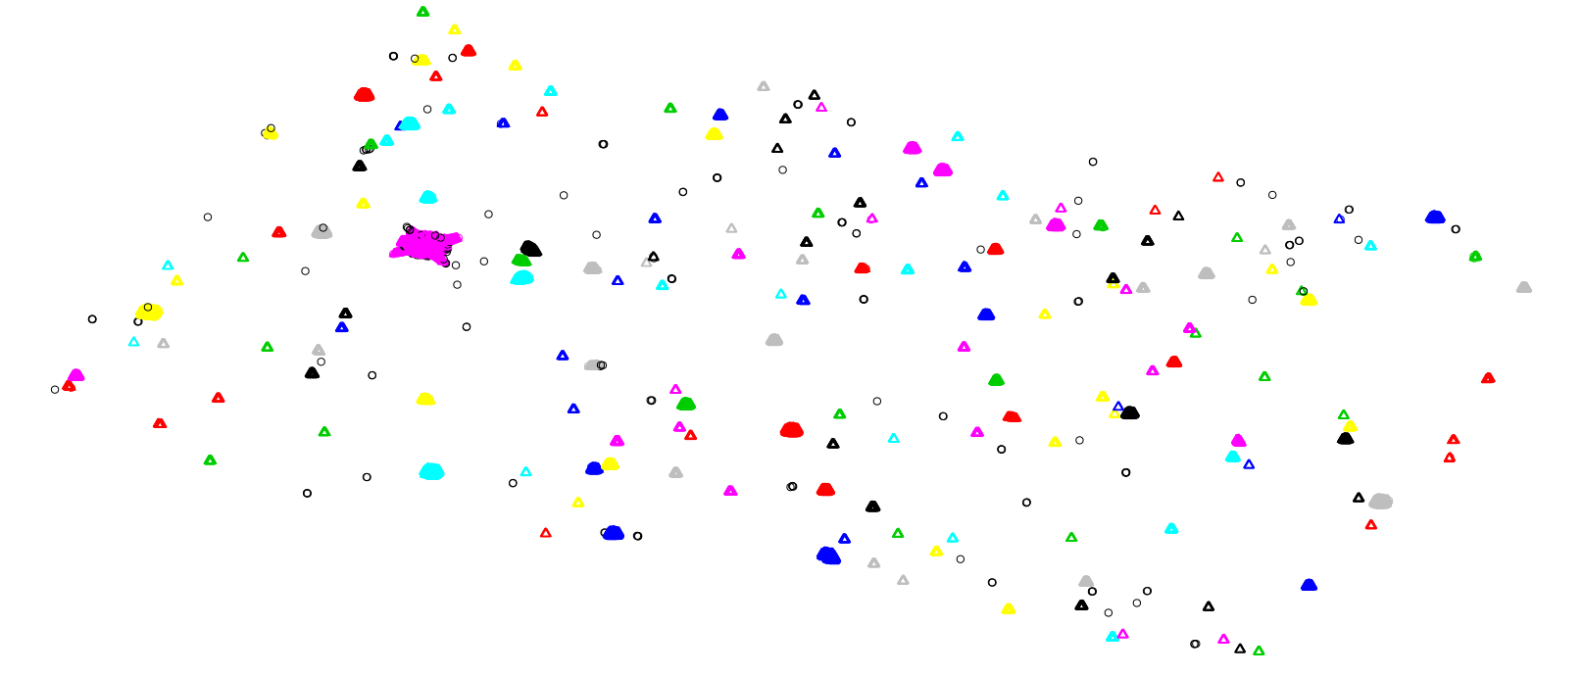
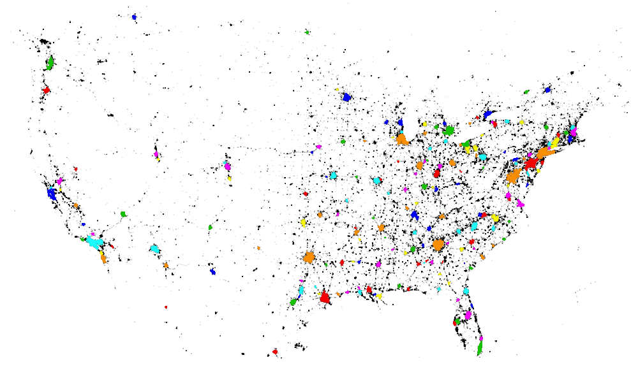
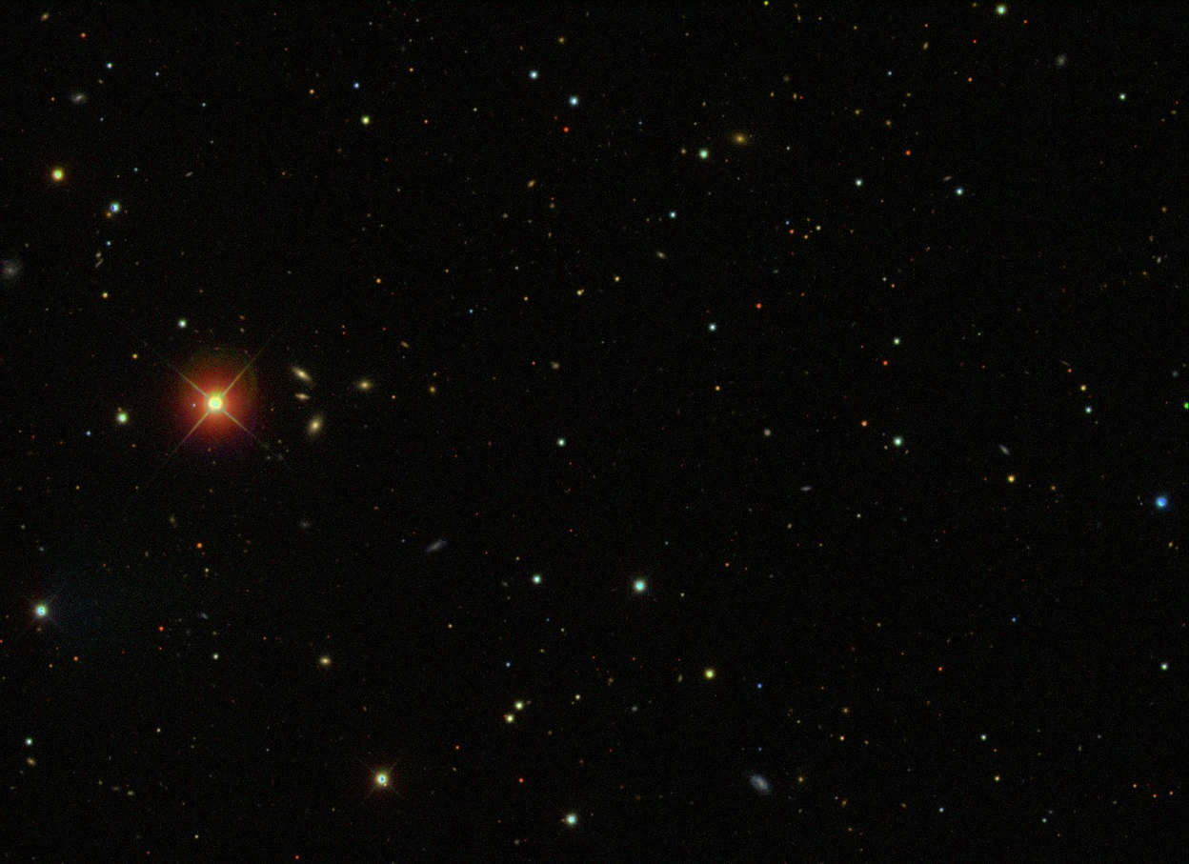
Density-based clustering
Discovers the number of clusters
Finds oddly-shaped clusters

Slide 5
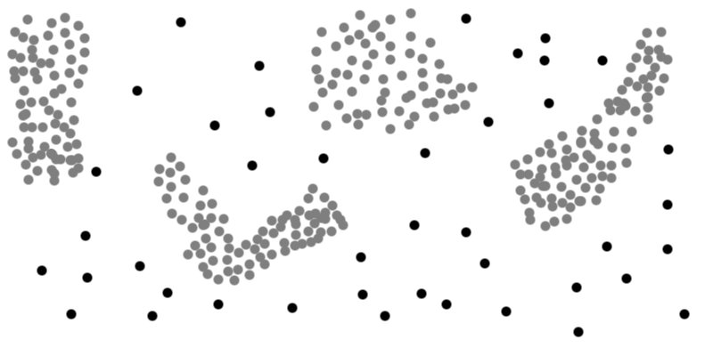
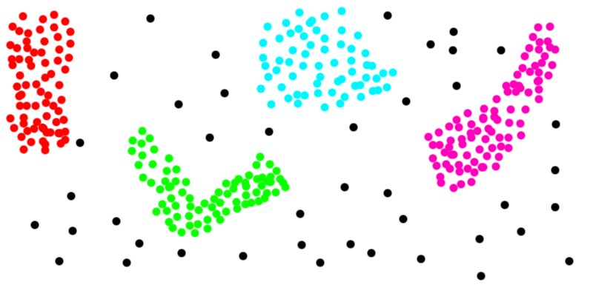
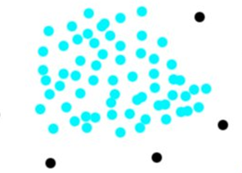
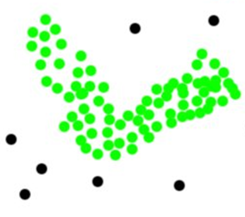
Clustering Example (DBSCAN^{[1]})
Goal: Find regions that meet minimum density and spatial distance characteristics
The two parameters that determine if a point is in a cluster is Epsilon (Eps), and MinPts
If the number of points in Eps is > MinPts, the point is a core point.
For every discovered point, this same calculation is performed until the cluster is fully expanded
Eps
MinPts
MinPts: 3
[1] M. Ester et. al., A density-based algorithm for discovering clusters in large spatial databases with noise, (1996)
Notes:
Attribute to Hans on slide, try and fix the transition between 5 and 6. Don’t say that we had gpu’s and were looking for
A problem. Change 1 on slide title.

Slide 6
MRNet – Multicast / Reduction Network
General-purpose TBON API
  Network: user-defined topology
  Stream: logical data channel
    to a set of back-ends
    multicast, gather, and custom reduction
  Packet: collection of data
  Filter: stream data operator
    synchronization
    transformation
Widely adopted by HPC tools
  CEPBA toolkit
  Cray ATP & CCDB
  Open|SpeedShop & CBTF
  STAT
  TAU
FE
F(x₁,…,x_{n})
CP
CP
CP
CP
CP
CP
BE
…
BE
…
BE
…
BE
app
app
app
app
app
app
app
app
app
app
app
app
app
app
app
app
Notes:
Forgot to mention reduction operation with streams. Clean up boxes

Slide 7
Computation in a Tree-Based Overlay Network
  Adjustable for load balance
  Output sizes MUST be
  constant or decreasing at each
  level for scalability
  MRNet provides this
  process structure
FE
Total Size of Packets:
≤10 MB
CP
CP
Total Size of Packets:
≤10 MB
BE
BE
BE
BE
Data Size:
10MB per BE
Notes:
Simple animation for each bullet point?
Should be constant/decreasing output size. Would hit scaling limits soon.
Nuke original bullet. Keep sub-bullet.
Mention that these are general features of MRNet (ideal computation). Replace symbol on <= with actual symbol.

Slide 8

MRNet Hybrid Computation
A hybrid computation includes GPU processing elements alongside traditional CPU elements.
In MRNet, GPUs were included as filters.
A combination of CPU and GPU filters were used in MRNet.
F(x₁,…,x_{n})
FE
CP
F(x₁,…,x_{n})
CP
CP
F(x₁,…,x_{n})
BE
…
BE
…
app
app
app
app
app
app
app
app

Slide 9

Intro to Mr. Scan
Merge
Mr. Scan Phases
Partition: Distributed
DBSCAN: GPU (on BE)
Merge: CPU (x #levels)
Sweep: CPU (x #levels)
FE
Merge
Sweep
CP
CP
DBSCAN
Sweep
BE
BE
BE
BE
FE
BE
BE
FS
BE
BE

Slide 10
Mr. Scan SC 2013 Performance
FS Read
224 Secs
FS Write
489 Secs
FS Read: 24 Secs
MRNet
Startup
130 Secs
DBSCAN
168 Secs
Partitioner
DBSCAN
Write Output:
19 Secs
Merge Time: 6 Secs
Merge & Sweep
Sweep Time: 4 Secs
Time: 0
Clustering 6.5 Billion Points
Time: 18.2 Min

Slide 11
Load Balancing Issue
In initial testing imbalances in load between nodes was a significant limiting factor in performance
  Increased run-time of Mr. Scan’s computation phase by a factor of 10.
Input point counts did not correlate to run times for a specific node
  Adding an additional 25 minutes to the computation
Resolving the load balance problem required numerous Mr. Scan specific optimizations
  Algorithm Tricks like Dense Box and heuristics in data partitioning

Slide 12
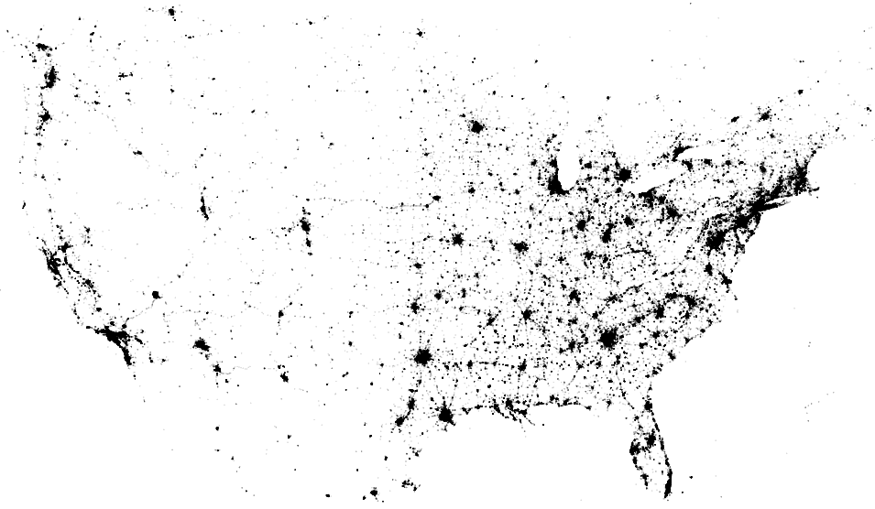
Partition Phase
Goal: Partitions computationally equivalent to DBSCAN
Algorithm:
  Form initial partitions
  Add shadow regions
  Rebalance
Notes:
Split the area so that we show points split in area. Label Eps.

Slide 13
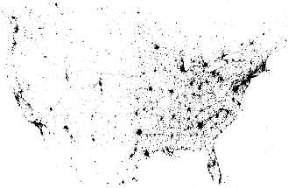

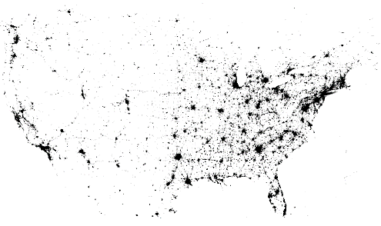
Distributed Partitioner

Slide 14
GPU DBSCAN Computation
DBSCAN computation is performed in two distinct steps on the leaf nodes of the tree
Step 1: Detect Core Points
Step 2: Expand core points and color
Block 1
Block 1
T
1
T
2
T
512
T
1
T
2
T
512
Block 2
Block 2
T
1
T
2
T
512
T
1
T
2
T
512
Block 900
Block 900
T
1
T
2
T
512
T
1
T
2
T
512
Notes:
Canidate Clusters == Chains. What happens to chain number 1/2 do after states merge. What is a thread block maybe replace with limited by gpu charactoristics.
Reference the cuda-dclust algorithm.
More spacing between text. Consistentcy with justification.

Slide 15


The DBSCAN Density Problem
Imbalances in point density can cause huge differences in runtimes between Thread Groups inside of a GPU (10-15x variance in time)
  Issue is caused by the lookup operation for a points neighbors in the DBSCAN point expansion phase.
$$ε$$
$$ε$$
Higher density results in higher neighbor count which increases the number of comparison operations

Slide 16


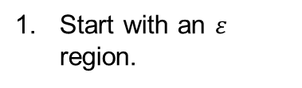

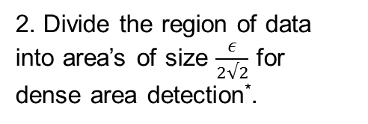

Dense Box
Dense Box eliminates the need to perform neighbor lookups on points in dense regions by labeling points as a member of cluster before DBSCAN is run.
Start with an $ε$ region.
2. Divide the region of data into area’s of size $\frac{ε}{2√2}$ for dense area detection*.
3. For each $\frac{ε}{2√2}$ area which
has point count >= MinPts. Mark points as members of a cluster. Do not expand these points.
$$\frac{ε}{2√2}$$
$$ε$$
$$\frac{ε}{2√2}$$
* $\frac{ε}{2√2}$chosen because it guarantees all points inside are within $ε$distance of each other.
15
Mr. Scan: Efficient Clustering with MRNet and GPUs

Slide 17
Challenges of the Hybrid Model
Debugging
  Difficult to detect incorrect output without writing application specific verification tools
Load Balancing
  GPUs increased the difficulty of balancing load both cluster wide and on a local node (due to large variance in runtimes with identical sized input)
  Application-specific solution required for load balancing
Existing distributed framework components stressed
  Increased computational performance of GPUs stress other non-accelerated components of the system (such as I/O)

Slide 18
Debugging Mr. Scan
Result verification complicated due to:
  CUDA Warp Scheduling not being deterministic
  Packet reception order not deterministic in MRNet
Both issues altered output slightly
  DBSCAN non-core point cluster selection is order dependent
  Output cluster IDs would vary based on packet processing order in MRNet
Easy verification of output, such as a bitwise comparison against a known correct output, not possible

Slide 19
Debugging Mr. Scan
We had to write verification tools to run after each run to ensure output was still correct
  Very costly in terms of both programmer time (to write the tools) and wall clock runtime
Worst of all…. Tools used for verification are DBSCAN specific.
  Generic solutions needed badly for increased productivity

Slide 20
Load Balancing
Load balancing between nodes proved to be a significant and serious issue
  Identical input sizes would result in vastly differing runtimes (by up to 10x)
  Without the load balancing work, Mr. Scan would not have scaled
Application specific GPU load balancing system implemented
  No existing frameworks could help with balancing GPU applications

Slide 21
Other components
GPU use revealed flaws that were hidden in the original non-GPU implementation of Mr. Scan.
I/O, start-up, and other components of the system impacted performance greatly
  Accounting for a majority of the run time of Mr. Scan
Solutions to these issued that scaled for a CPU based application, might not for a GPU based application

Slide 22
Work in progress
We are currently looking at ways to perform load balance/sharing in GPU applications in a generic way
We are looking at methods that do not change the distributed models used by applications and require no direct vendor support
  Getting users or hardware vendors to make massive changes to their applications/hardware is hard

Slide 23
Questions?

Slide 24
Characteristics of a ideal load balancing framework
Require as few changes to existing applications as possible
  We cannot expect application developers to give up MPI, MapReduce, TBON, or other computational frameworks to solve load imbalance
Take advantage of the fine grained computation decomposition we see with GPUs/Accelerators
  Course grained solutions (such as moving entire kernel invocations/processes) limits options for balancing load.
Needs to play by the hardware vendors “rules”
  We cannot rely on support from hardware vendors for a distributed framework.

Slide 25
An Idea: Automating Load Balancing
Have a layer above the GPU but below the user application framework to manage and load balance GPU computations across nodes
GPU Manager would execute user application code on device while attempting to share load with idle GPUs
User Application (MPI/MRNet/
MapReduce/etc)
GPU Manager
GPU Device

Slide 26
An Idea: A Load Balancing Service
Application Supplies
CUDA functions (PTX, CUBIN)
Argument Data for functions passed to manager
Application ask to run function binary. Supplying a data stride and number of compute blocks
Compute Blocks created and added to queue
At completion of all queued blocks results returned
Program sent to device, pointer to function saved
Data forwarded to device
Function Ptr + Data Offset
Function Ptr + Data Offset
SIMD
Result
Function Binary
Data
Persistent kernel in GPU would pull off this queue and execute the user’s function

Slide 27
An Idea: A Load Balancing Service
On detection of an idle GPU, load is shared between nodes.
User Binary transfer to new host
Binary sent to GPU
Data for compute blocks
Data copied to GPU
Block moved, updating data offset
Block moved, updating data offset
Function Ptr + Data Offset
Function Ptr + Data Offset
Function Ptr + Data Offset
Binary
Data
SIMD
SIMD
Data
Binary
Block Executed, Result returned to originating node

