Slide 1
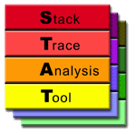
DySectAPI: A Scalable Prescriptive Parallel Debugging Model
Gregory L. Lee, Dong H. Ahn, Nicklas Jensen, Sven Karlson, Matt LeGendre, Jesper Nielsen, Niklas Nielsen, Martin Schulz
Scalable Tools Workshop, August 2015

Slide 2
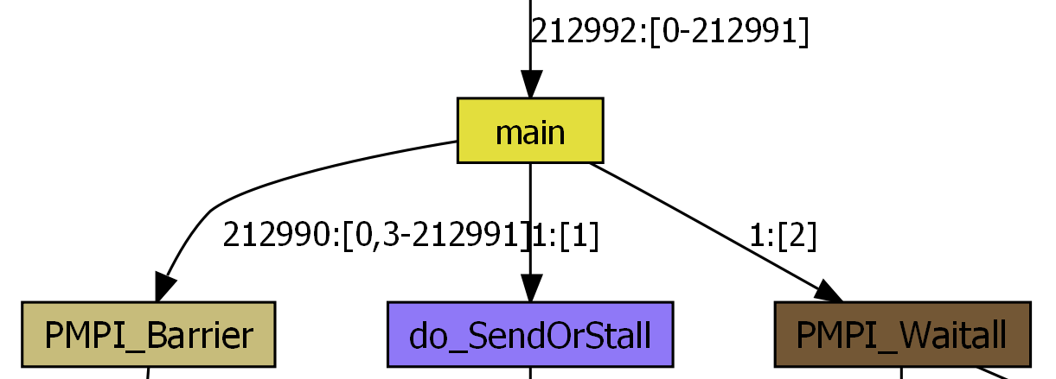
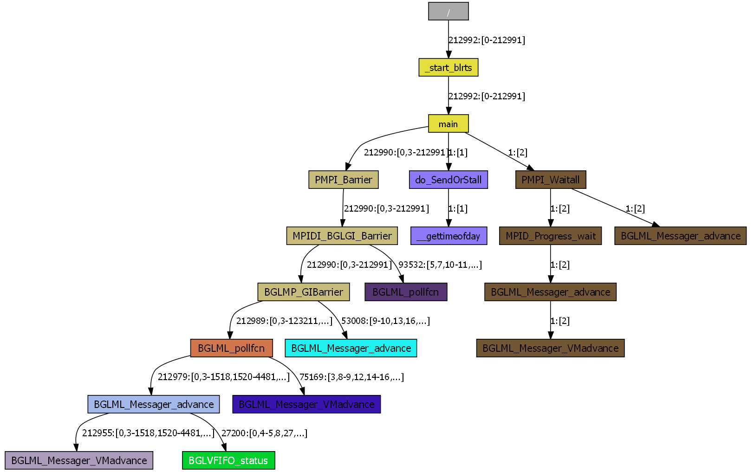
Our Stack Trace Analysis Tool has been a huge success for debugging
Task 0
Task 1
Task 2
Your Favorite Debugger

Slide 3
STAT crucial in real-world use cases
March 2015: pf3d hang at 3,145,728 tasks on Sequoia
May 2013: Hang at 1,572,864 tasks on Sequoia
September 18, 2012: Hang on 1,179,648 tasks, 72 racks of Sequoia
August 2012: Lustre memory bug causing app slowness
April 2012: Identified bad HW on 24 racks of Sequoia
March 2012: PMGR hangs on large zin jobs up to 40K tasks
October 2011: Diagnosed hang at 4K tasks on Coastal
June 2011: Identified bad compute node from job running on 65,536 processors of BlueGene/L
October 2010: Identified hang in MPI library at 65,536 tasks on Dawn BlueGene/P
Several other success stories!
In order to capture more bugs, STAT needs new capabilities

Slide 4
How to efficiently debug parallel HPC applications?
We propose a “prescriptive” debugging model
Allows developers to codify their debugging intuition
Debug session runs in batch
Reduces the search space for tool and developer
Prototype implementation of this model
Dynamic Scalable Event Chain Tracing (DySect) API
Leverages STAT’s scalable infrastructure
MRNet, StackWalkerAPI, ProcControlAPI, SymtabAPI, LaunchMON, FGFS

Slide 5
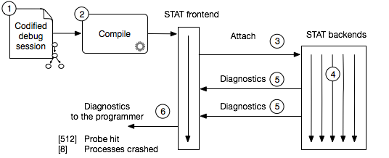
The prescriptive debugging workflow
Programmer codifies debug session before execution
Aggregated data collected during execution
Refine debug session based on data and iterate
Notes:
Flyt tree lidt længere væk

Slide 6
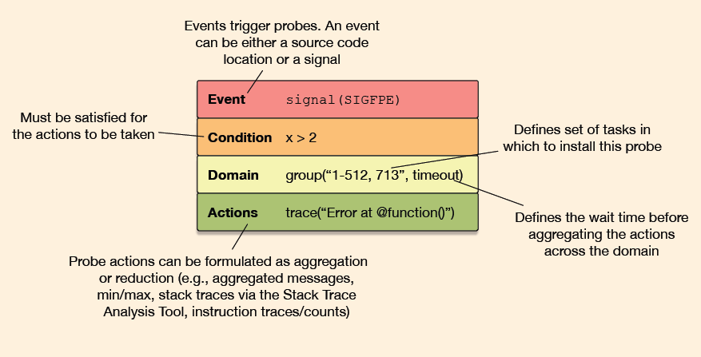
Probe trees are designed to capture user’s typical debugging workflow
The basic building block is a probe
Event – Initial trigger
Condition – Predicate for probe triggering
Domain – Process scope and synchronization
Action – User actions performed upon triggering
Probes are linked together to form a tree
Models the manual debugging process
Reduces search space across processes, code, and dynamic execution
Coarse-grained analysis at root
More fine-grained analysis towards leaves
Probe 1
Probe 2
Probe 4
Probe 3
Notes:
• I have been mentioning probes very briefly, but want you to get an idea about what they can express, before explaining the bits and pieces
• To represent a more general concept than a breakpoint and ideally wanted to merge different debugging mechanisms into one abstract one
• A probe is our instrumentation point abstraction, made of 4 components
• Events, Conditions or predicates, Domain or process grouping and synchronization and Actions
• As a single probe represents one instrumentation step, multiple linked probes then represents the multiple steps that a typical debugging session consists of.
• I will use the next couple of slides, going trough these components
• For tool writes, this would be where you, hopefully, could see potential possible extensions and for developers, be where you could identify possible requirements or needs, to useful.
• I mentioned, that questions can come underway - but I would like to keep the feed-back to after I have gone through my slides

Slide 7
An example probe tree
Probe 1
Probe 2
Probe 4
Processes
Probe 3
Probe *p1 = Probe(
Event(“Main.C:100”),
Cond(“iteration = 100”);
Probe *p2 = Probe(
Event(“calculateEnergy”),
Act::Cluster(“totalEnergy”));
Probe *p3 = Probe(
Domain::Cluster(rep = true),
Act::DumpCore());
Probe *p4 = Probe(
Event(“bar”));
Act::Trace(“@ranks() called bar));
p1->link(p2);
p2->link(p3);
p1->link(p4);
Probe 1
Probe 2
Probe 4
Probe 3
Time

Slide 8
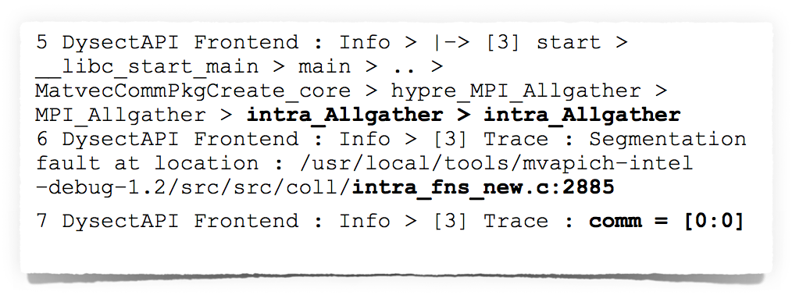
DySectAPI was used to identify real-world bug in MPI implementation
Seg fault encountered sporadically in AMG at 3,456 MPI processes
Two debugging sessions required to find bug
Just 7 lines of output from DySectAPI
Bug was due to uninitialized communicator data structure

Slide 9
We are exploring how dynamic instrumentation can be of use
Easy to determine where things go wrong
Hard to determine how we got there
Integration with Matt LeGendre’s Boar tool
Boar records what instructions are executed
DySectAPI will look for deviant behavior (i.e., basic block counts or anomalous call paths)

Slide 10
Data analysis will help us capture many bugs
Analysis opportunities
Watch points
Local invariants
Global invariants
Invariant deduction
Predefined condition
Predefined condition
Invariant deduction
Process grouping
Clustering
Buckets
Data exposure
Continuous analysis
Post-gather analysis
Feature extraction
Invariant checking
Feature comparison
Predefined global invariant
Predefined local invariant
Data exposure
Change points

Slide 11
DySectAPI enables building a tool ecosystem
Probe trees can vary in their scope
Generic probe trees (MPI hang detector, crash handler, etc.)
Template probe trees
Application-specific probe trees
Bug-specific probe trees
Learn from STAT success

Slide 12
DySectAPI enables debugging a wide range of bugs in HPC applications
More information:
IPDPS 2015 paper
SC 14 Poster
Greg Lee lee218@llnl.gov
Questions?

Slide 13
Backup

Slide 14
Prescriptive debugging with DySectAPI via probe trees

Slide 15
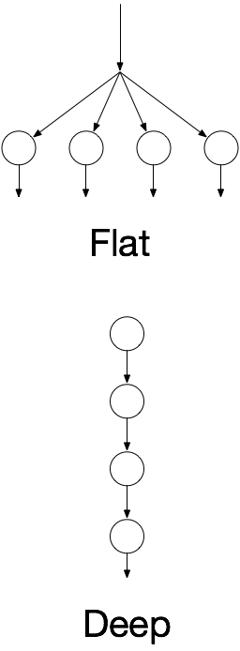
Experimental Setup
Conducted on Cab at LLNL,1,296 nodes with 2 x Intel Xeon E5-2670 processors, 16 cores per node
Microbenchmark measuring overhead of two probe trees
Filtering of processes in the deep tree

Slide 16
Evaluating Scalability using an Analytical Run-Time Overhead Model
We use an analytical run-time overhead model to predict scalability at large scale
Models overhead of probe installation and probe invocation
Costs obtained measuring DySectAPI on specific system
At large scale network cost dominates
Compare modelled and empirical data
More details about the model in the paper
Notes:
Vær tydeligt med hvad vi har gjort. Tilpasset modellen til Cab for at se hvordan det skalerer.

Slide 17
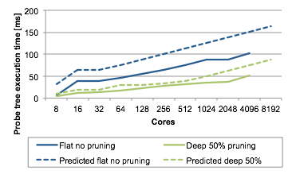
Results
Model is always overly conservative
Flat probe tree discrepancy due to concurrent communication not modelled
Notes:
N / 2 processes N / 4
Logarithmic scalability achieved
Skifte til Probe tree execution time -> Probe tree overhead [ms]
Hvad koster det at bruge debuggeren/

Slide 18
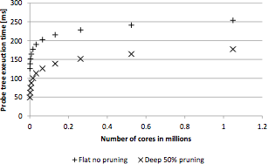
Predicting Extreme Scalability
Logarithmic scalability predicted
Notes:
Change figure to look more like before
Skifte til Probe tree execution time -> Probe tree overhead [ms]

