Slide 1
Spack Working Group Outbrief
Scalable Tools Workshop 2015
Participants:
Todd Gamblin (LLNL), Bernd Mohr (Jülich), Matt Legendre (LLNL), Mark Krentel (Rice), Laksono Adhianto (Rice), Josh Stone (RedHat)

Slide 2
Goals
Technical overview of writing a Spack Package
Create Spack packages for existing tools
Understand differences between Spack and other packaging tools
Focus on differences with EasyBuild, used at Jülich
EasyBuild is developed by system support team at HPC U. Ghent

Slide 3
Technical Spack Overview
Showed how to make Spack packages
Automatically, from tarball URLs
From git & svn repositories
Dependencies
Specifying dependencies
Spack needs a better notion of build-only dependencies
CMake, hpctoolkit-externals are included in HPCToolkit DAG
Harmless (For this tool) but unnecessary
Version ranges, dependency constraints
Discussed a lot of details of packaging
How to pass specific configure arguments
How to build in subdirectories
Spack’s compiler model & cross compiling
We can cross-compile, but it could be prettier
depends_on(‘papi@4:’)

Slide 4
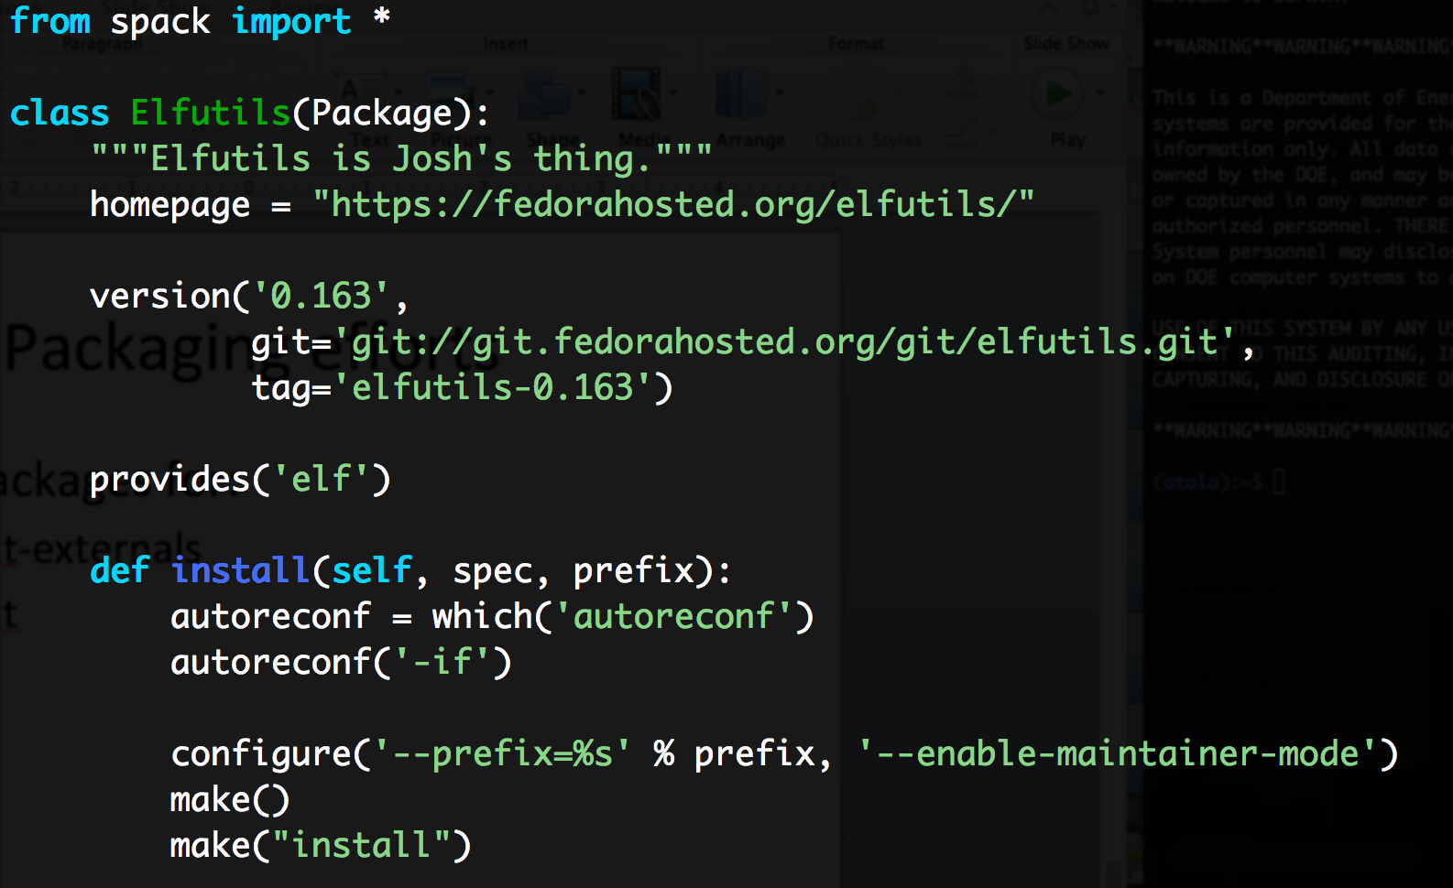
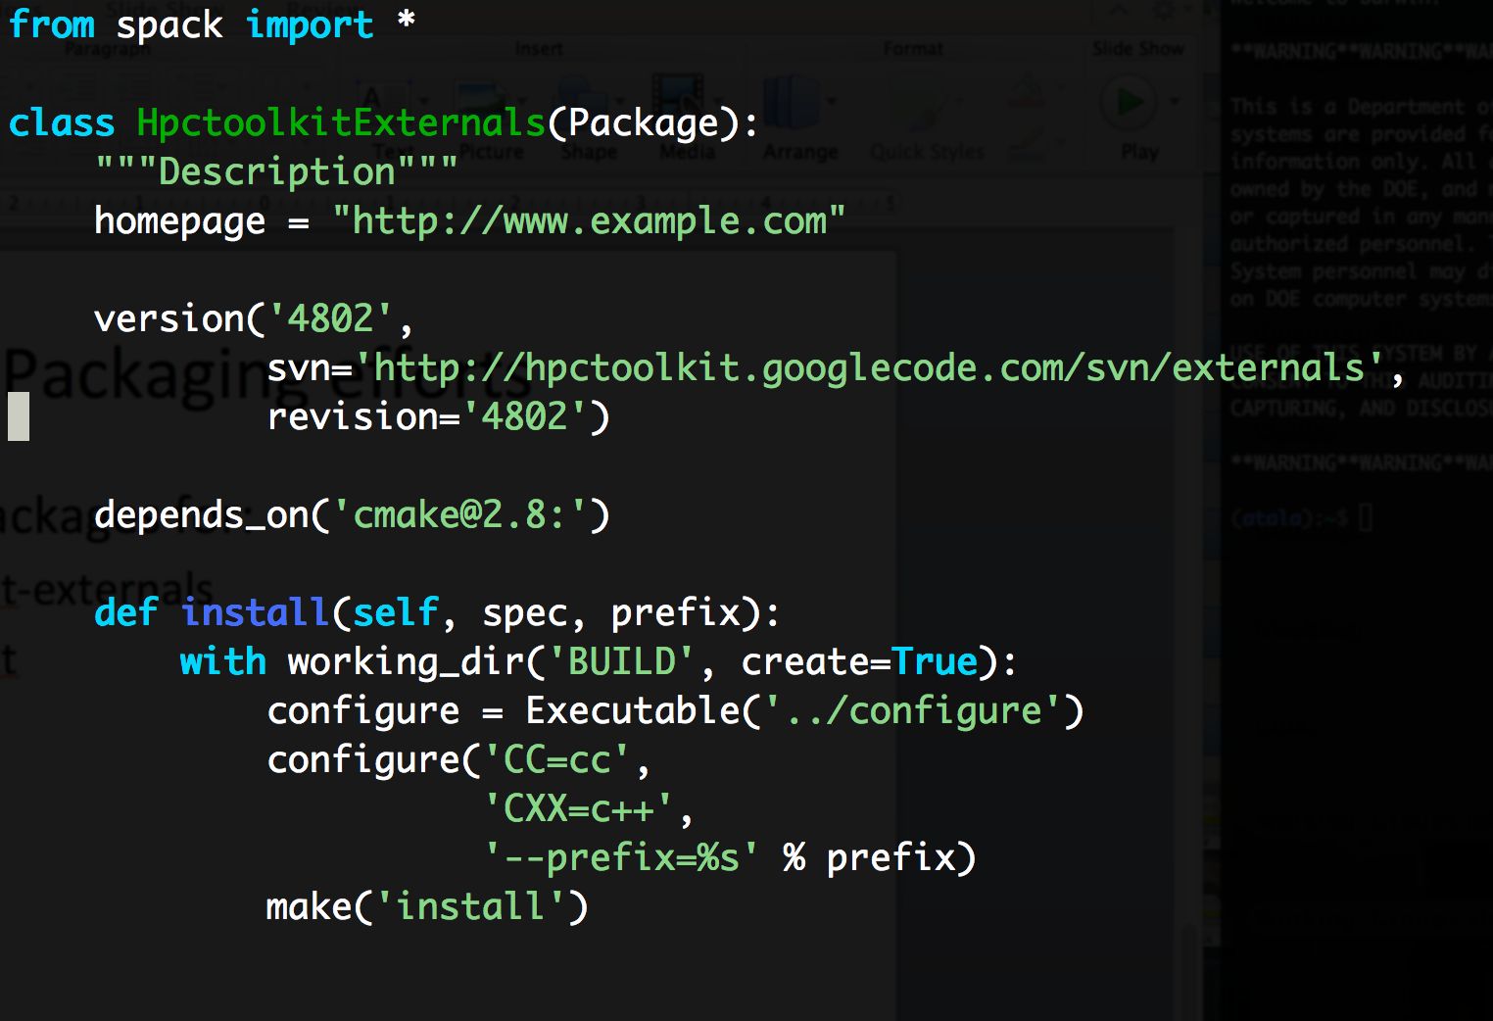
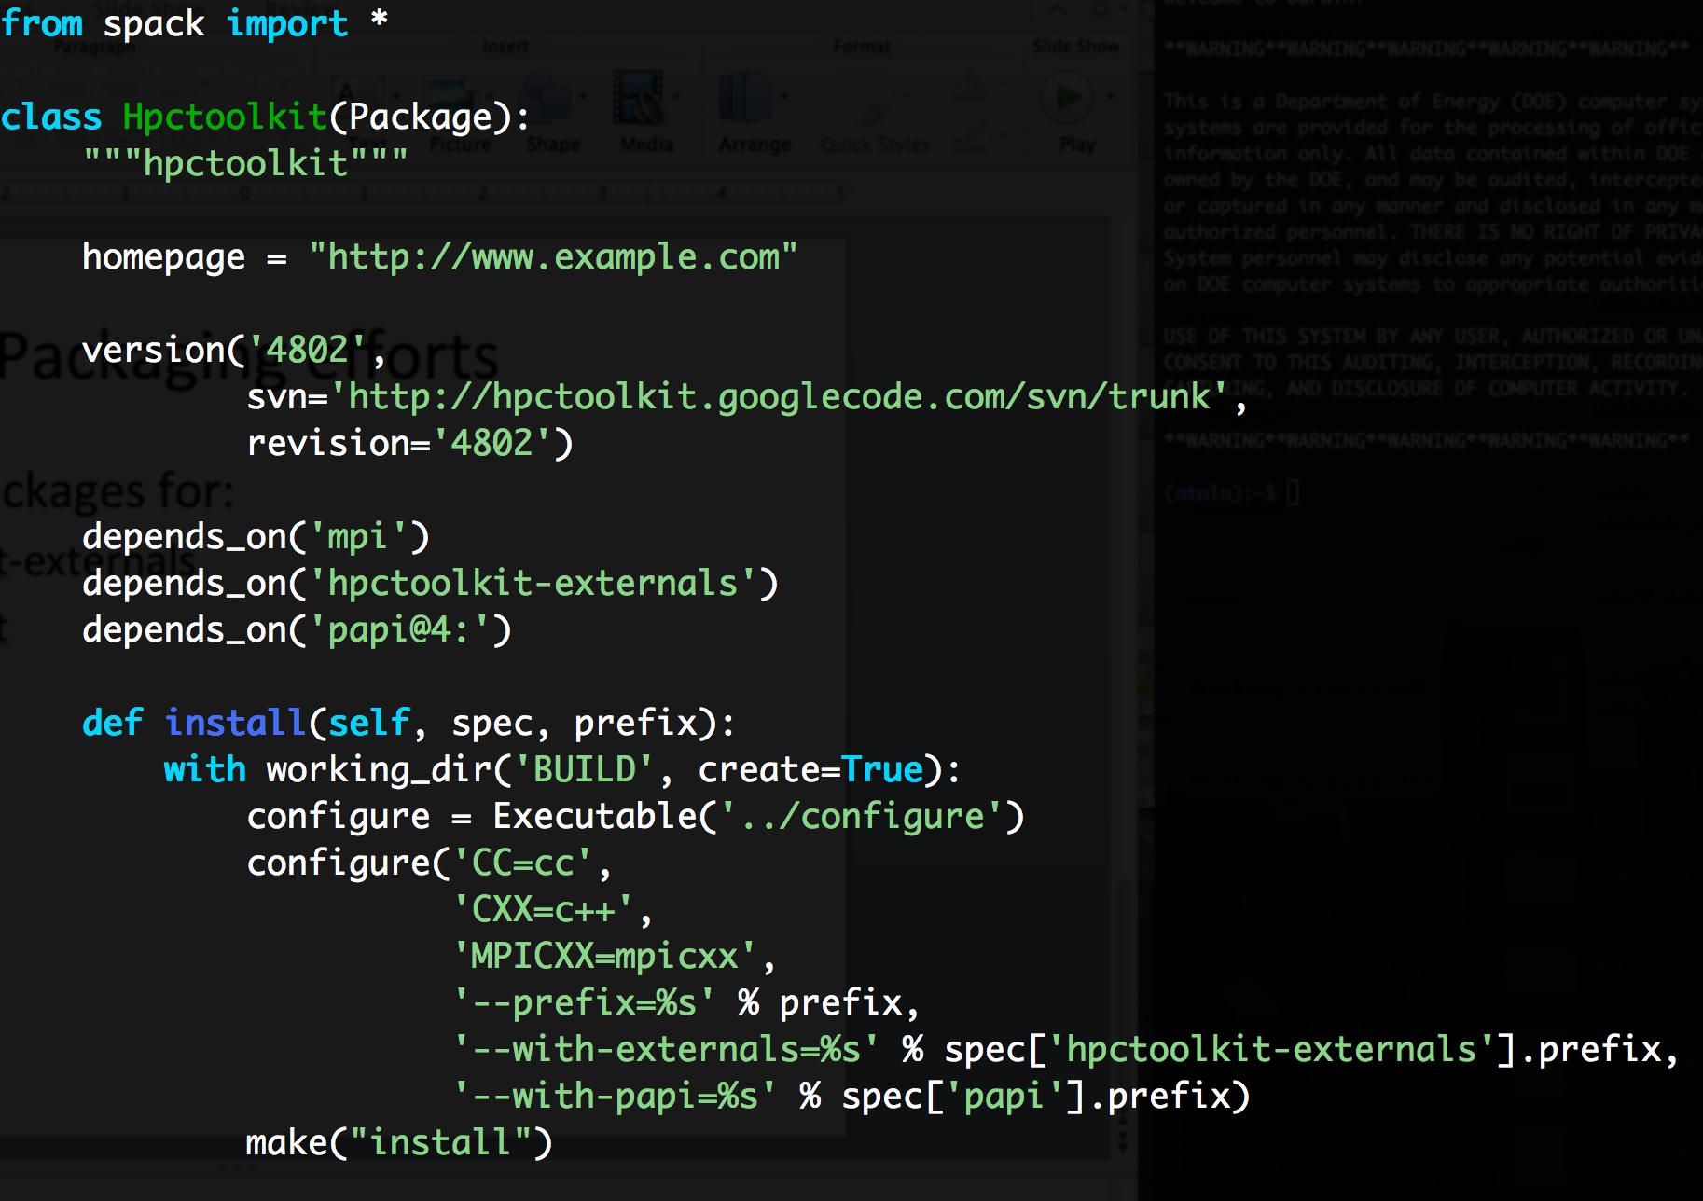
Created 3 packages
Created packages for:
hpctoolkit-externals
hpctoolkit
elfutils

Slide 5
Differences between Spack and EasyBuild
“These tools are trying to do the same thing at a high level, but at very specific points made different design decisions” -Bernd Mohr (approximately)
Spack
Compilers:
Finds system compilers
Can build own compilers but not mandatory
Packages
Single file per package
Many versions (templated)
Dependencies:
Fine-grained dependency DAG model
Can express version ranges
Virtual & optional dependencies
Looser, flexible syntax (can be specific if you want)
Can still reproduce each build.
Environment management:
Use RPATHs
Generate modules too (not hierarchical, not Lmod yet)
EasyBuild
Compilers:
Common dependencies lumped into a “toolchain” to manage an entire stack
Must bootstrap toolchain by building compilers (Bernd fixing)
Packages split between:
easyblocks: (like Spack install method)
easyconfigs: dependency metadata, configure args per unique configuration (like Spack concrete spec)
Dependencies:
Only specific versions in configs
No ranges (reproducibility concerns)
Tighter model (same command always does same build)
Environment management:
Rely heavily on modules (Lmod)
Better hierarchical module support

